Slide 1
Emerging Risks of Noncompliance: The Nuts and Bolts of Avoiding a Disastrous Audit in Alternate Sites
Leigh Davitian, JD
Chief Executive Officer
Dumbarton Group, LLC
Washington, DC

Slide 2
Disclosure
Leigh Davitian is an independent consultant. She has no relevant financial relationships with ineligible companies to disclose.
This continuing education activity is managed by Innovatix* and AffinityCE. Innovatix* is accredited by the Accreditation Council for Pharmacy Education as a provider of continuing pharmacy education.
Innovatix* and AffinityCE as well as planners and reviewers have no relevant financial relationships with ineligible companies to disclose. Neither Innovatix* nor Affinity CE support or endorse any product or service mentioned in this activity. Disclosure will be made when a product is discussed for an unapproved use.
The material presented for this session has been reviewed by the Innovatix* Institute CE Committee and AffinityCE and has been found to be free of any content influence or commercial bias.
Commercial Support was not received for this activity.
*Innovatix now operates under Premier Alternate Site Programs

Slide 3
Learning Objectives
Discuss increased government investigations in LTC settings, LTC pharmacies, and specialty pharmacies
Identify increased PBM audits in pharmacies and describe measures to minimize exposure
Identify important protocols and self-policing practices to help minimize Medicare fraud, abuse, waste and errors in pharmacies and LTC settings

Slide 4
Goals of Today’s Presentation
Define ”COMPLIANCE” and YOUR role
Explain the “tenets” of healthcare compliance
Identify ”ENFORCERS” of compliance
Who is conducting the audits
Identify what is being audited
How to minimize non-compliance or prolonged audits

Slide 5
What is ”Compliance” in the Workplace
“Compliance refers to the act or process of abiding by all legal, statutory, regulatory, professional and ethical standards on federal, state and local levels pertinent to a said industry”. The specific requirements can vary, depending largely on the industry and type of business”.
Leigh D.

Slide 6
Compliance is in ALL industries
Accounting
Sarbanes Oxley Act (SOX)
Generally Accepted Accounting Principles (GAAP)
Tax laws and regulations
Manufacturing
Anti-corruption
Import/Export controls
Fair competition
Food Industry
Food and Drug Administration
United States Department of Agriculture
Interstate Commerce

Slide 7
ALERT: YOU are dealing with HUMANS not WIDGETS!

Slide 8
“Compliance Applicability” Litmus Test
Do you work for a health care entity/facility?
Nursing home
Hospital
Assisted Living Facility
Home Health
Hospice
Pharmacy
Responsibilities include
C-Suite
Administrative role – Management, Receptionist, Biller
Clinical
Nurse, Doctor, Pharmacist
Do you interact with any individuals who are Medicare/Medicaid patients?

Slide 10
Genesis of Increased Focus on Compliance in Healthcare

Slide 11
Five Tenets of Government Compliance Goals
Identify and marginalize fraud, abuse, waste, errors
Eliminate old providers from the Medicare program
Minimize new providers from entering Medicare program
Reduce overall payment errors
Recover billions of dollars in improper payments

Slide 12
Bi-Partisan Support To Combat Fraud and Abuse
FACT:
Estimates place losses at approximately $60 billion annually (and growing)
President Obama passed the Affordable Care Act
Created aggressive statutory provisions to minimize Medicare/Medicaid fraud, abuse, waste and errors
President Trump pledged to ramp up enforcement efforts
President Biden continues to promote the tenets of ACA
Created better data sharing between agencies

Slide 13
Fundamentals of Fraud and Abuse
Medicare fraud is:
When one obtains or attempts to obtain services or payments by dishonest means with intent and knowledge and willingness
Medicare abuse is:
When one does not follow good medical practices, inconsistent with accepted sound medical, business, or fiscal practices and result in unnecessary costs, improper payments or services not medically necessary

Slide 14
Evolution of Fraud and Abuse: New Categories: FWAE
Medicare, Medicaid no longer tolerates “ERRORs”
Human error
Computer error
Sloppiness
Laziness
Lack of sophistication
Medicare, Medicaid no longer tolerates “WASTE”
Incurring unnecessary costs as a result of deficient management, practices, or controls (such as over-prescribing/utilization)
Misuse
Excess
Superfluous

Slide 15
What are Examples of Health Care Laws and Regulations
Social Security Act
Omnibus Budget Reconciliation Act of 1987
Affordable Care Act
Anti-Kickback Statute
False Claims Act
Health Insurance Portability and Accountability Act
Health Information Technology Economic and Clinical Health (HITECH)
Patient Protection and Affordable Care Act

Slide 16
POLLING QUESTION #1
The following health care employees are responsible to assist with compliance efforts:
(a) C-Suite executives
(b) Billing staff
(c) IT staff
(d) All of the above

Slide 17
Who Regulates Healthcare Compliance?

Slide 18
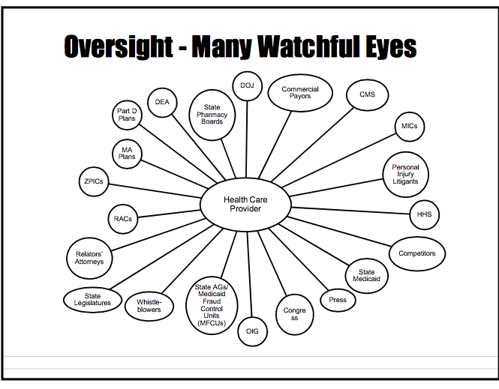
C
CMS

Slide 19
The “BIG” Enforcers
Health and Human Services Agents
Department of Justice Agents
United States Attorneys’ Office
State Attorney General’s Office
Federal Bureau of Investigation (FBI)
Internal Revenue Service (IRS)
State Medicaid Fraud Control Units
State Law Enforcement

Slide 20
The “Enforcers” from A-far
Recovery Audit Contractors (RACs)
Comprehensive Error Rate Testing (CERT)
State-Wide Probe Reviews (STPR)
Medical Review Auditors (MRA)
National Correct Coding Initiative (NCCI)
Claims Processing Contractors (CPC)
Notes:
The RAC continues to focus the majority of efforts toward adoption of CMS evidence-based coverage policies and site-of-service issues (e.g. identifying overpayments). CERT audits are aimed at measuring improper payments. ZPICs target potential fraud in the Medicare program and can audit the integrity of all Medicare claims for a particular provider with both pre- and post-pay audits. While ZPIC audits are similar in many ways to other CMS audits currently being performed nationwide they do differ in one very important aspect – potential Medicare fraud implications. Another difference is that when auditors arrive at your place of business they will come armed with information. Instead of random audits, ZPICs will have information in hand, and they will know exactly what they want to zero in on. Essentially, if you are being audited, it is because the ZPICs MAY already have evidence that there is a problem with your billing. What does this information mean for facilities that are within one of these zones? Consequences of a ZPIC review include payment denials, recoupment of overpayments, and referral to other law enforcement agencies. Because ZPICs can refer cases to the Department of Justice, Office of Inspector General, or other law enforcement agencies, a ZPIC review may only be the first step in a long legal battle.

Slide 21
Hybrid Enforcers: Virtual and On-Site
Medicare Administrative Contractors (MACs)
Office of Inspector General Auditors (OIG)
Provider Relief Fund Auditors (PRFA)
Health Care Fraud Prevention and Enforcement Action Team (HEAT)
Targeted Probe and Education (TPE) Audits
Recovery Audit Contractors (RACs)
Uniformed Program Integrity Contractors (UPICs)
Medicaid Integrity Auditors (MIA)
Drug Enforcement Administration (DEA)
Pharmacy Benefit Manager Auditors (PBM)

Slide 22
ATTENTION: All Pharmacies AND Pharmacists!!

Slide 23
Pharmacy Compliance Audits Come in Many Forms
Desktop audits
Invoice audits
Onsite/field audits
Prepay claims review
Investigational pharmacy audits
Medicare pharmacy audit
Private insurance audits
PBM audits

Slide 24
Primer to PBM Audit
Determine the deadline to respond
Immediately identify the “specific date” the pharmacy must respond
Determine the PBM's focus
Letter should identify PBM’s focus
Familiarize yourself with audit sections of the Provider Manual
Request a response extension
Extension can be granted between 10-14 days
Identify staff pharmacist lead on said audit
Notes:
Working with pharmacy benefit managers (PBMs) can be a frustrating experience for pharmacies. The PBM possesses the pharmacy’s money. If the PBM does not pay the pharmacy, the pharmacy is harmed, regardless of whether the PBM has the right to withhold money.

Slide 25
Primer to PBM Audit
Review, organize, and rehabilitate
Pharmacy needs to carefully review each document submitted
Submission of documents
Pharmacy should organize submitted documents in an organized manner
Copies and explanatory letter
Pharmacy should include an explanatory cover letter with a detailed listing of submitted documents
Pharmacy should submit documents via hardcopy and certified mail
Follow up with the PBM
After submitting documents, the pharmacy should follow up PBM to confirm documents arrived in a timely manner
Notes:
SO -- The pharmacy’s mind-set should be “Let’s solve the problem” in advance rather than being defensive and attempting to “win the argument” with a PBM audit.

Slide 26
Preparation for On-site Audits
Set up small area so auditors can examine documentation without interfering with the daily course of business
Have a dedicated staff member present to retrieve documents, make copies and answer questions
Never grant the auditor(s) unsupervised access to pharmacy records
Instruct staff to direct all questions to the dedicated staff member
Do not volunteer additional information
Request an exit interview
Immediately create a “corrective plan of action to correct”
DOCUMENT EVERYTHING!!!
This Photo by Unknown Author is licensed under CC BY

Slide 27
New Government Focus on Pharmacy: Billing, Coding, Documentation
Accurate Coding of Reimbursement Requests – When billing federal payors, pharmacies must ensure that they are coding their reimbursement requests accurately. In the event of a federal compliance audit or billing fraud investigation, coding errors can lead to exposure for fines, recoupments, treble damages, and other penalties
Bundling and “Upcoding” Compliance – Two particular areas of coding compliance that often lead to trouble are bundling and “upcoding.” In many cases, pharmacies are required to bill related reimbursements at a reduced, bundled rate. Unbundling is considered a form of federal billing fraud, as is billing a medication at a higher rate than the one prescribed by the applicable program guidelines
Establishing Medical Necessity for Federally-Reimbursed Medications – Federal healthcare benefit programs only provide reimbursement for prescription drugs that are medically necessary. Each program has its own definition of medical necessity, and pharmacies must ensure that they are only submitting reimbursement requests for authorized (i.e. medically necessary) medications
Recordkeeping Compliance – As with DEA compliance, recordkeeping is a key aspect of federal program billing compliance as well. Pharmacies must keep comprehensive records of their program billings, and they must be able to substantiate these billings with appropriate supporting documentation
Double-Billing Federal Programs and Private Payors – Double-billing is a common issue in pharmacy billing fraud investigations, and evidence of double-billing will be considered a “red flag” by auditors and federal investigators alike

Slide 28
DEA Audits – Enhancing Scope
Prescription Drug Ordering – Pharmacies’ compliance obligations attach at all stages of the prescription lifecycle, from ordering through dispensing
Prescription Drug Inventory Management – Inventory management is often a central focus of DEA audits and inspections.
Prescription Management and Fraud Monitoring – When filling prescriptions, the DEA takes the position that pharmacies must play an active role in preventing fraud.
Electronic Prescription Compliance – Electronic prescription compliance is extraordinarily complex, and it requires a devoted and detail-oriented approach.
Prescription Drug Security (Theft Prevention) – Pharmacies are obligated to adopt physical and logical security controls in order to prevent the theft of prescription medications from their premises and during transit.
Transfer and Disposal of Prescription Drugs – Pharmacies also face multiple specific compliance obligations with regard to the transfer and disposal of prescription drugs.
Pharmacy Recordkeeping Practices – Pharmacies in the U.S. are subject to comprehensive recordkeeping requirements under federal law.
Prescription Drug Dispensing and Diversion Control – The final primary aspect of DEA compliance for pharmacies falls in the area of prescription drug dispensing and diversion control.

Slide 29
Recovery Audit Contractors (RACs)
Review payments of all enrolled providers
Detect and correct post-payment improper payments
Over-payments and under-payments
Implement actions to prevent future improper payments
“Provider Flagging”
Providers and suppliers must report and return Medicare and Medicaid overpayments within 60 days of identification
Part C and Part D providers included in new reporting
Contractors paid based on percentage of recoupments

Slide 30
Uniformed Program Integrity Contractors (UPICs)
UPICs audits the integrity of Medicare Part A and Part B, durable medical equipment, prosthetics, orthotics, and supplies
Focus on nursing homes, home health providers, and hospice facilities
UPICs use sophisticated data mining, statistical analysis, and trending activities to identify healthcare providers
Review utilization, coding, and/or billing practices that are aberrant or suspicious
UPICs audits are not random but based on a belief that non-compliance has occurred
UPICs WILL eventually arrive unannounced for an on-site audit

Slide 31
National Medicaid Integrity Program
What is an Audit Medicaid Integrity Contractor? (Audit MICs)
​Which providers are subject to audit?
​What to expect in a MIC Audit?
Medicaid Integrity Educational ​​Toolkits
Pharmacy Education Toolkit
​Pharmacy Audit Dispensing Toolkit
​Nursing Home Toolkit

Slide 32
New Audit Tool: Targeted Probe and Educate (TPE)
INFORMATION IS COMPLETE
BENEFICIARY IS ELIGIBLE
PROVIDER IS ELIGIBLE
CODES ARE CORRECT
MEDICAL NECESSITY IS MET
DOCUMENTATION DID NOT MEET NECESSITY
MISSING OR INCOMPLETE CERTIFICATIONS
SUSPECTED OVER-UTILIZATION
BLATANT WASTE

Slide 33
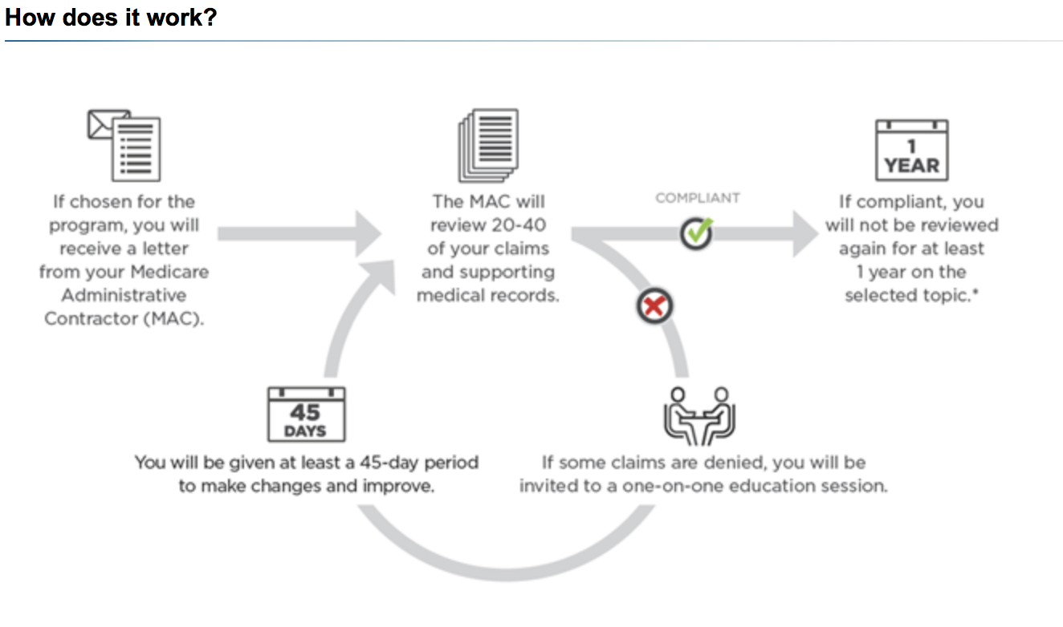

Slide 34
Polling Question #2
Medicare has recently increased their auditing efforts focus on:
Flagrant fraud on a “white crime level”
Lack of updating Medicare Enrollment requirements
Improper billing practices
Falsification of medical documents

Slide 35
Minimizing Negative Audit Outcomes

Slide 36
Enhance Your Best Practices
Know and follow all applicable Federal laws, rules, regulations
Know and follow applicable state laws, rules and pharmacy regulations
Know the trends of audits in your respective industry
Train staff of their role in assisting with compliance and audit process
Perform self audits and self-policing protocols
Create immediate “corrective plan of action” to mitigate any further deficiencies
Submit corrected information and/or plans of correction to auditing entities

Slide 37
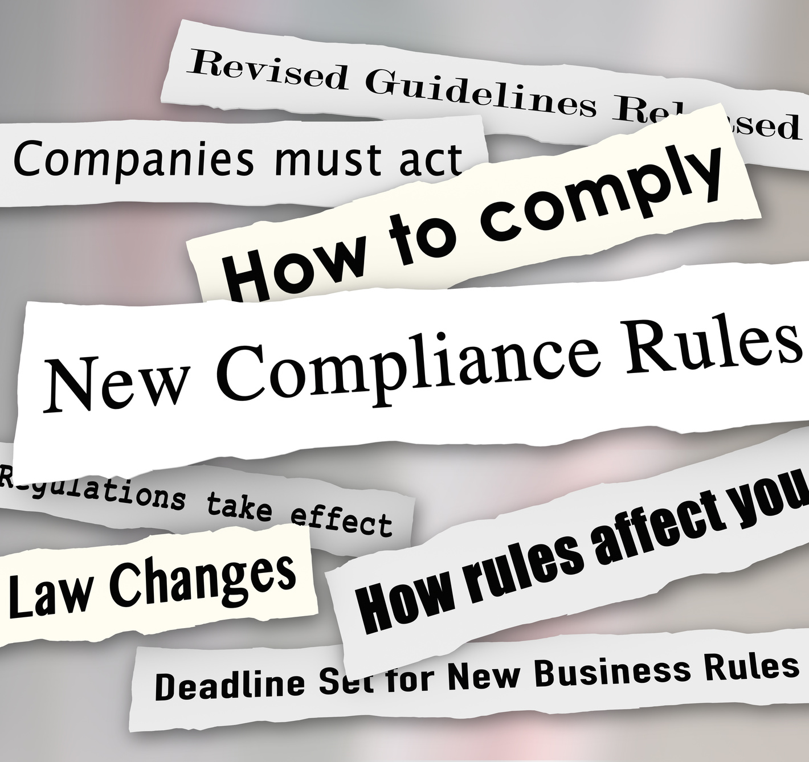
(7) Core Elements in Compliance Program
Designate a chief compliance officer in charge of operating the program
Develop and distribution of written policies, procedures and standards of conduct
Implement regular education and training program for employees
Develop an internal audit system to identify problem areas
Develop a system to report deficiencies and problem areas
Develop a process where employees can come forward without fear of retaliation
Develop a means to quickly remedy problems in a systematic, transparent way
This Photo by Unknown Author is licensed under CC BY

Slide 38
Minimize Exposure to Deficiencies in Audits
Maintain an organic Medicare compliance program
An effective compliance program should be your first line of defense
Conduct ongoing education
All staff must receive regular training on how to detect, minimize, and deter Medi-Medi fraud, abuse, waste. and errors
Education can be offered through internal in-service programs, webinars, off-site conferences, and timely government materials
Perform frequent self-audits
Review billing and coding behavior
Monitor denied claims for patterns of deficiencies
Understand proper documentation
Understand proper medical necessity

Slide 39
Summary of Today’s Presentation
Multiple federal agencies work collectively to detect and penalize providers who embrace fraud, abuse, waste and errors
Pharmacies can reduce a prolonged PBM audit by establishing detailed standard operating procedures and educating key staff
Minimizing the chances of becoming non-compliant under Medicare is by conducting regular “self-audits” and implementing self-policing measures

Slide 40
Helpful Resources and Links
Medicare.gov
http://www.medicare.gov Medicare Learning Network® (MLN)
http://www.cms.gov/Outreach-and-Education/Medicare-Learning-Network-MLN/MLNGenInfo/index.html
MLN Provider Compliance Web Page
http://www.cms.gov/Outreach-and-Education/Medicare-Learning-Network
MLN/MLNProducts/ProviderCompliance.html
Senior Medicare Patrol (SMP)
http://smpresource.org
Medicare Contact Information for Local Contractors
http://www.cms.gov/MLNProducts/Downloads/CallCenterTollNumDirectory.zip
OIG Fraud Prevention & Detection
http://oig.hhs.gov/fraud
OIG Provider Self-Disclosure Protocol http://oig.hhs.gov/compliance/self-disclosure-info
Health Care Fraud Prevention and Enforcement Action Team (HEAT)
http://www.stopmedicarefraud.gov/heattaskforce
Stop Medicare Fraud:
http://www.stopmedicarefraud.gov

Slide 41
QUESTIONS? Contact information: SLDavitian@dumbartonassociates.com

