Slide 1
Antibiotic Stewardship in Long-Term Care
Kati Shihadeh, PharmD, BCIDP
Infectious Diseases Pharmacy Specialist
Denver Health Medical Center

Slide 2
DISCLOSURES
Dr. Kati Shihadeh has no relevant financial relationships with ineligible companies to disclose.
This continuing education activity is managed by Innovatix* and AffinityCE. Innovatix* is accredited by the Accreditation Council for Pharmacy Education as a provider of continuing pharmacy education.
Innovatix* and AffinityCE as well as planners and reviewers have no relevant financial relationships with ineligible companies to disclose. Neither Innovatix* nor Affinity CE support or endorse any product or service mentioned in this activity. Disclosure will be made when a product is discussed for an unapproved use.
The material presented for this session has been reviewed by the Innovatix* Institute CE Committee and AffinityCE and has been found to be free of any content influence or commercial bias.
Commercial Support was not received for this activity.
*Innovatix now operates under Premier Alternate Site Programs

Slide 3
Objectives
Recognize risk factors for and consequences of antibiotic resistance
Describe key principles and importance of antibiotic stewardship
Discuss regulatory requirements for antibiotic stewardship
State effective antibiotic stewardship interventions in long-term care facilities (LTCF) and nursing homes (NH)

Slide 4
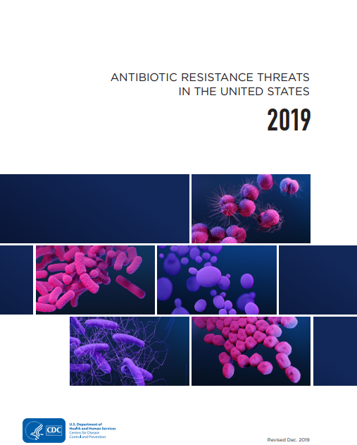
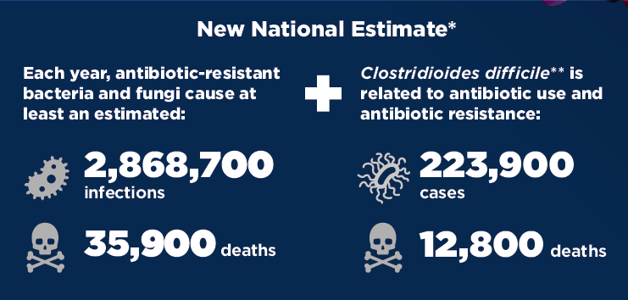
Antibiotic Resistance
CDC. Antibiotic Resistance Threats in the United States, 2019. Atlanta, GA: U.S. Department of Health and Human Services, CDC; 2019.

Slide 5
Antibiotic Resistance in LTCF and NH
1.8 – 3.6 million infections in NH residents/year
  150,000 hospitalizations & 388,000 deaths
Multiple studies have assessed rates of colonization of methicillin-resistant Staphylococcus aureus (MRSA), MDR Gram-negatives, vancomycin-resistant Enterococcus (VRE) of persons in LTCF
  43% of persons in LTCF colonized with MRSA, MDRGN, or VRE
  39% acquired resistant organism from LTCF
Castle NG, et al. Am J Infect Control 2012;39:4
van Buul LW, et al. JAMDA 2012;13:568.e1-13
Notes:
1.8 million – Castle NG, et al. Am J Infect Control 2012;39:4
Why: Frequent transfer from acute care hospitals
Horizontal transmission of resistant organisms
Widespread antibiotic use
van Buul LW, et al. JAMDA 2012;13:568.e1-13

Slide 6
Antibiotic Resistance = Worse Outcomes
Mortality risk associated with MRSA bacteremia vs MSSA bacteremia: OR 1.93; p < 0.001
VRE bacteremia vs VSE associated with hospital LOS and mortality
Colonization with resistant bacteria in patients with cirrhosis hospitalization and mortality
Cosgrove SE, et al. Clin Infect Dis 2003:36(1):53–59.
Shamsaddini A, et al. Gastroenterology 2021;161:508-21
Prematunge C et al. Infect. Control Hosp. Epidemiol 2016;37(1):26-35.
Notes:
Cosgrove SE, et al. Clin Infect Dis 2003:36(1):53–59.
Gut colonization with resistant bacteria in patients with cirrhosis were more likely to be hospitalized in the next 90 days and die within the next year
Shamsaddini A, et al. Gastroenterology 2021;161:508-21
VRE: Prematunge C et al. Infect. Control Hosp. Epidemiol 2016;37(1):26-35.

Slide 7
Antibiotic Resistance = Worse Outcomes
Risk of death with carbapenem-resistant vs carbapenem-susceptible Klebsiella pneumoniae bacteria
p<0.001
OR 3.71 (1.97-7.01)
Patel et al. Infect Control Hosp Epidemiol 2008;29:1099-1106
Notes:
Patel et al. Infect Control Hosp Epidemiol 2008;29:1099-1106

Slide 8
Polling Question #1
What is the biggest risk factor for persons at a LTCF or NH to be colonized or infected with a resistant organism?
  Age
  Antibiotic exposure
  Invasive devices
  Decubitus ulcer or open wounds
Notes:
B

Slide 9
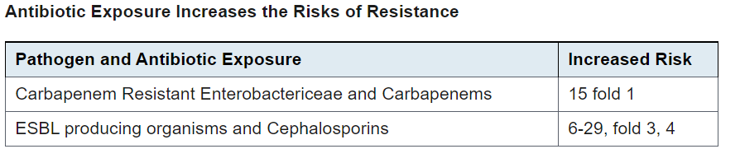
Antibiotic Exposure → Antibiotic Resistance
TMP/SMX and fluoroquinolone exposure → independent risk factors for resistance of these antibiotics in Enterobacterales and P. aeruginosa
Patel G, et al. Infect Control Hosp Epidemiol 2008;29:1099-1066.
Zaoutis TE, et al. Pediatrics 2005;114:942-9.
Talon D, et al. Clin Microbiol Infect 2000;6:376-84.
Loeb MB, et al. Am J Epidemiol 2003;157:40–47.
Notes:
Patel G, et al. Infect Control Hosp Epidemiol 2008;29:1099-1066.
Zaoutis TE, et al. Pediatrics 2005;114:942-9.
Talon D, et al. Clin Microbiol Infect 2000;6:376-84.
Loeb MB, et al. Am J Epidemiol 2003;157:40–47. TMP/SMX and fluoroquinolones, which accounted for over one third of all antibiotics prescribed in this study, were found to be independent risk factors for TMP/SMX and fluoroquinolone resistance in Enterobacteriaceae and P. aeruginosa, respectively. These findings are important, since Enterobacteriaceae cause the vast majority of urinary tract infections in residents of long-term care facilities

Slide 10
Antibiotic Use
20-50% of antibiotics prescribed in hospitals are inappropriate or unnecessary
30% of antibiotics prescribed in doctor’s offices and emergency departments are unnecessary
Centers for Disease Control and Prevention, The 6|18 Initiative: Accelerating Evidence into Action. 2021. Available at:
https://www.cdc.gov/sixeighteen/hai/index.htm#:~:text=Many%20prescribed%20antibiotics%20are%20inappropriate%20or%20unnecessary%2C%20including%3A,in%20doctor%E2%80%99s%20offices%20and%20emergency%20departments%20are%20unnecessary
Notes:
Centers for Disease Control and Prevention, The 6|18 Initiative: Accelerating Evidence into Action. 2021. Available at:
https://www.cdc.gov/sixeighteen/hai/index.htm#:~:text=Many%20prescribed%20antibiotics%20are%20inappropriate%20or%20unnecessary%2C%20including%3A,in%20doctor%E2%80%99s%20offices%20and%20emergency%20departments%20are%20unnecessary.

Slide 11
Polling Question #2
What percent of nursing home residents receive an antibiotic in a year?
  Up to 15%
  Up to 30%
  Up to 50%
  Up to 70%
Notes:
70%

Slide 12
Polling Question #3
What percent of antibiotics prescribed to nursing home residents are prescribed incorrectly?
  Up to 25%
  Up to 50%
  Up to 75%
  Up to 90%
Notes:
75%

Slide 13



Antibiotic Use in Nursing Homes
Antibiotics comprise ~40% of all NH prescriptions
Centers for Disease Control and Prevention. Antibiotic Use in Nursing Homes. Nov 5, 2013. Accessed May 27, 2016. http://www.cdc.gov/getsmart/healthcare/learn-from-others/factsheets/nursing-homes.html
Notes:
https://www.cdc.gov/longtermcare/prevention/antibiotic-stewardship.html
*incorrectly = prescribing the wrong drug, dose, duration or reason
1 AHCA Quality Report 2013.
2 Lim CJ, Kong DCM, Stuart RL. Reducing inappropriate antibiotic prescribing in the residential care setting: current perspectives. Clin Interven Aging. 2014; 9: 165-177.
3 Nicolle LE, Bentley D, Garibaldi R, et al. Antimicrobial use in long-term care facilities. Infect Control Hosp Epidemiol 2000; 21:537–45.
Daneman N, et al. JAMA IntMed 2012;173:673-82.
Benoit et al. JAGS 2008;56:2039-44.
Antibiotics are among the most frequently prescribed medications in nursing homes, with up to 70% of residents in a nursing home receiving one or more courses of systemic antibiotics when followed over a year.
Similar to the findings in hospitals, studies have shown that 40–75% of antibiotics prescribed in nursing homes may be unnecessary or inappropriate.
Centers for Disease Control and Prevention. Antibiotic Use in Nursing
Homes. Nov 5, 2013. Accessed May 27, 2016. http://www.cdc.gov/
getsmart/healthcare/learn-from-others/factsheets/nursing-homes.html

Slide 14
Risk Factors for Infections/Antibiotic Use
Why do so many NH residents receive antibiotics?
  Age-related
    Co-morbidities
    Functional impairments
    Alterations to immune system
    Invasive devices
  Facility-related
    Close-proximity living
    Contact with staff and medical equipment
Notes:
Residents have co-morbidities, functional impairments, frail, age→ pathologic alterations in immune system, invasive devices
Elderly people living in nursing homes and residential care facilities
are at increased risk of acquiring infectious diseases. This is
because of several age-related factors, such as pathologic alterations
to the immune system, functional disability, the presence of chronic
diseases, and the use of invasive devices, such as urinary catheters
and feeding tubes.1e3 In addition, several facility-related factors
increase the risk of spread of infectious diseases, such as residents
living in close proximity and participating in social activities, and
serial close contact of dependent residents with staff and medical
equipment.1,3 Because of the presence of these biological and environmental
factors, infectious diseases commonly occur in nursing
homes and residential care facilities

Slide 15
Harms from Antibiotic Use in LTCF and NH
Adverse drug events (ADE)
Antibiotic-associated diarrhea and C. difficile
Colonization and/or infection with antibiotic-resistant organism
Loeb MB, et al. Am J Epidemiol 2003;157:40–47.
Notes:
Harms from antibiotic overuse are significant for the frail and older adults receiving care in nursing homes. These harms include risk of serious diarrheal infections from Clostridium difficile, increased adverse drug events and drug interactions, and colonization and/or infection with antibiotic-resistant organisms.
Loeb MB, et al. Am J Epidemiol 2003;157:40–47. TMP/SMX and fluoroquinolones, which accounted for over one third of all antibiotics prescribed in this study, were found to be independent risk factors for TMP/SMX and fluoroquinolone resistance in Enterobacteriaceae and P. aeruginosa, respectively. These findings are important, since Enterobacteriaceae cause the vast majority of urinary tract infections in residents of long-term care facilities

Slide 16
Harms from Antibiotics - ADE
Allergic reactions
Drug-drug interactions
A study of 410 NH residents who had an ADE found antibiotics to be an independent risk factor for having an ADE [OR: 4.0 (2.5-6.2)] and a preventable ADE [OR: 3.0 (1.6-5.8)] when compared to controls
Field TS, et al. Arch Intern Med 2001;161:1629-34.
Notes:
Harms from antibiotic overuse are significant for the frail and older adults receiving care in nursing homes. These harms include risk of serious diarrheal infections from Clostridium difficile, increased adverse drug events and drug interactions, and colonization and/or infection with antibiotic-resistant organisms.
Case-control study of ADE among residents in 18 nursing homes. For each ADE they randomly selected a control from same nursing home. Abx were associated with a greater risk of having ADE than antipsychotics and antidepressants.
Field TS, et al. Arch Intern Med 2001;161:1629-34.

Slide 17
Harms from Antibiotic Use – C. difficile
Risk Factors for C. difficile in LTCF and NH
Advanced age
Antibiotic exposure
Hospitalizations/healthcare exposure
Extended length of stay
Underlying comorbid conditions
Simore AE. N Eng J Med 2010; 58:1556
Notes:
Harms from antibiotic overuse are significant for the frail and older adults receiving care in nursing homes. These harms include risk of serious diarrheal infections from Clostridium difficile, increased adverse drug events and drug interactions, and colonization and/or infection with antibiotic-resistant organisms.
Simore AE. N Eng J Med 2010; 58:1556

Slide 18

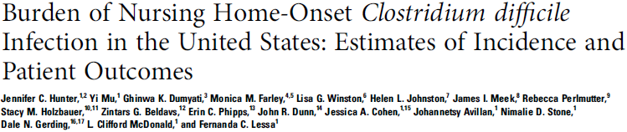
112,800 nursing home-onset cases in 2012
  28% hospitalized within 7 days of positive test
  19% recurred within 60 days
  8% died within 30 days
  Case reviews: 76% received antibiotics within prior 12 weeks
Hunter JC. Open Forum Infect Dis. 2016 Jan 18;3(1)
Notes:
Antibiotic exposure a key risk factor – 76% of residents with CDI exposed to antibiotics
In smmary, because of the worsening antibiotic resistance and Cdiff epidemics, optimizing antibiotic use in NHs is essential

Slide 19
Harms from Antibiotic Use - Resistance
Antibiotic Exposure
Infection or colonization with resistant pathogens
Worse outcomes

Slide 20
What is Antibiotic Stewardship?
Optimize treatment of infections while reducing adverse effects of antibiotics
  Only use antibiotics when needed
  Correct drug
  Correct dose
  Correct duration of therapy
Notes:
Antibiotic stewardship refers to a set of commitments and actions designed to “optimize the treatment of infections while reducing the adverse events associated with antibiotic use.” The Centers for Disease Control and Prevention (CDC) recommends that all acute care hospitals implement an antibiotic stewardship program (ASP) and outlined the seven Core elements which are necessary for implementing successful ASPs. CDC also recommends that all nursing homes take steps to improve antibiotic prescribing practices and reduce inappropriate use.

Slide 21
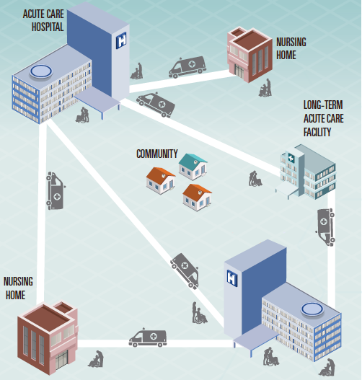
Where is Antibiotic Stewardship Needed?
Antibiotic
Stewardship
Is
Important
EVERYWHERE
CDC. Antibiotic Resistance Threats in the United States, 2019. Atlanta, GA: U.S. Department of Health and Human Services, CDC; 2019.
Notes:
It can’t be a siloed effort with focus only on the inpatient or outpatient setting. Antibiotics need to be used appropriately everywhere.
Even if you achieve perfect antibiotic use within the walls of your hospital, if the clinic down the street prescribes 10 days of amox-clav to every patient who presents with the sniffles, it’s going to have an effect on your hospital.
Patients don’t stay in one setting forever, they move from one setting to another and AMS is equally important at these transition points in a patients care.
Citation for abx threat report: CDC. Antibiotic Resistance Threats in the United States, 2019. Atlanta, GA: U.S. Department of Health and Human Services, CDC; 2019.

Slide 22
Centers for Medicare and Medicaid Services
September 2016 – LTCF are required to have an antimicrobial stewardship program (ASP)
  In place by Nov 2017
  ASP must include the use of antibiotic use protocols
  ASP must include a system to monitor antibiotic use
  Pharmacist will review medical chart during monthly drug regimen review when resident is receiving antibiotic
Federal Register / Vol. 81, No. 192 / Tuesday, October 4, 2016 / Rules and Regulations. Pg 68688-68872
Notes:
https://www.hhs.gov/sites/default/files/1.3-cooper-cop-changes-for-abx-steward-508.pdf
Federal Register / Vol. 81, No. 192 / Tuesday, October 4, 2016 / Rules and Regulations. Pg 68688-68872
We are requiring facilities to
develop an Infection Prevention and
Control Program (IPCP) that includes an
Antibiotic Stewardship Program and
designate at least one Infection
Preventionist (IP).
We proposed that the facility’s IPCP
must also include an antibiotic
stewardship program that includes
antibiotic use protocols and systems for
monitoring antibiotic use and recording
incidents identified under the facility’s
IPCP and the corrective actions taken by
the facility.

Slide 23
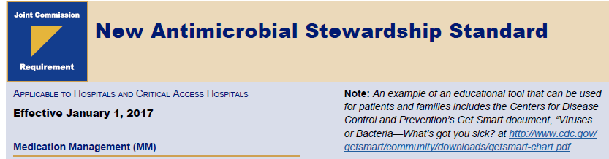
The Joint Commission
Standard MM.09.01.01
  The organization (hospitals, critical access hospitals, nursing care centers) has an antimicrobial stewardship program based on current scientific literature.
Notes:
TJC survey found AMS in nursing care centers to have the following barriers: Limited resources, Clinical uncertainty due to resident factors, Most prescriptions done as telephone order, High staff turnover, Patient/family demand
January 2017, antibiotic stewardship standard went into effect for nursing care centers

Slide 24
Joint Commission Elements of Performance
Leaders establish antimicrobial stewardship as an organizational priority
The organization educates staff and practitioners involved in antimicrobial ordering, dispensing, administration, and monitoring about antimicrobial resistance and antimicrobial stewardship practices
Notes:
Examples of leadership commitment to an antimicrobial stewardship program are as follows: Accountability documents, Budget plans, Infection prevention plans, Performance improvement plans, Strategic plans, Using the electronic health record to collect antimicrobial stewardship data
Education occurs upon hire or granting of initial privileges and periodically thereafter

Slide 25
Joint Commission Elements of Performance
The organization educates residents, and their families as needed, regarding the appropriate use of antibiotics
The organization has an antimicrobial stewardship multidisciplinary
team that includes the following members, when available:
  Infectious diseases physician
  Infection preventionist
  Pharmacist
  Practitioner
Notes:
Examples of leadership commitment to an antimicrobial stewardship program are as follows: Accountability documents, Budget plans, Infection prevention plans, Performance improvement plans, Strategic plans, Using the electronic health record to collect antimicrobial stewardship data
Education occurs upon hire or granting of initial privileges and periodically thereafter

Slide 26
Joint Commission Elements of Performance
The organization’s antimicrobial stewardship program includes the following CDC core elements:
  Leadership commitment
  Accountability
  Drug expertise
  Action
  Tracking
  Reporting
  Education
Notes:
Examples of leadership commitment to an antimicrobial stewardship program are as follows: Accountability documents, Budget plans, Infection prevention plans, Performance improvement plans, Strategic plans, Using the electronic health record to collect antimicrobial stewardship data
Education occurs upon hire or granting of initial privileges and periodically thereafter

Slide 27
Joint Commission Elements of Performance
The organization’s antimicrobial stewardship program uses organization-approved multidisciplinary protocols
  Examples: Formulary restrictions, plan for IV to PO conversions, treatment guidelines
The organization collects, analyzes, and reports data on its antimicrobial stewardship program
The organization takes action on improvement opportunities identified in its antimicrobial stewardship program.
Notes:
Examples of protocols: Antibiotic Formulary Restrictions
l Assessment of Appropriateness of Antibiotics for Community-Acquired Pneumonia, SSTI
l Care of the Long Term Care Patient with a Urinary Tract Infection or CDI
l Facility Guidelines for Antimicrobial Use in Adults
l Plan for Parenteral to Oral Antibiotic Conversion
l Preauthorization Requirements for Specific Antimicrobials

Slide 28







CDC Core Elements for Nursing Homes
CDC. The Core Elements of Antibiotic Stewardship for Nursing Homes. Atlanta, GA: US Department of Health and Human Services, CDC; 2015.
Available at: http://www.cdc.gov/longtermcare/index.html
Notes:
Accountability – identify physician, nursing, and pharmacy leads responsible for promoting and overseeing ams
Drug expertise - Establish access to consultant pharmacists or other individuals with experience or training in antibiotic stewardship for your facility
Action Implement at least one policy or practice to improve antibiotic use
Tracking Monitor at least one process measure of antibiotic use and at least one outcome from antibiotic use in your facility
Reporting Provide regular feedback on antibiotic use and resistance to prescribing clinicians, nursing staff and other relevant staff
Education Provide resources to clinicians, nursing staff, residents and families about antibiotic resistance and opportunities for improving antibiotic use
Citation: Suggested citation:
CDC. The Core Elements of Antibiotic Stewardship for Nursing Homes. Atlanta, GA: US Department of Health and Human Services, CDC; 2015. Available at: http://www.cdc.gov/longtermcare/index.html

Slide 29
Leadership Commitment
Demonstrate commitment to improving antibiotic use
  Written statements
  Include stewardship-related duties in job descriptions
  Communicate expectations
  Create a culture
Notes:
Nursing home leaders commit to improving antibiotic use. Facility leadership, both owners and administrators, as well as regional and national leaders if the facility is part of a larger corporation, can demonstrate their support in the following ways:
Write statements in support of improving antibiotic use to be shared with staff, residents and families
Include stewardship-related duties in position descriptions for the medical director, clinical nurse leads, and consultant pharmacists in the facility
Communicate with nursing staff and prescribing clinicians the facility’s expectations about use of antibiotics and the monitoring and enforcement of stewardship policies
Create a culture, through messaging, education, and celebrating improvement, which promotes antibiotic stewardship.

Slide 30
Accountability
Empower the medical and nursing directors to set standards
  Educate providers and nurses about stewardship policies and practices
  Review antibiotic use data to ensure best practices
Engage consulting pharmacist
  Medication regimen review
  Report antibiotic use data

Slide 31
Pharmacist Expertise
Work with consultant pharmacist
  Provide support for ASP training (e.g. MAD-ID, SIDP)
Partner with ASP leads at hospitals
Notes:
Work with a consultant pharmacist who has received specialized infectious diseases or antibiotic stewardship training. Example training courses include the Making a Difference in Infectious Diseases (MAD-ID) antibiotic stewardship course (http://mad-id.org/antimicrobial-stewardship-programs/), and the Society for Infectious Diseases Pharmacists antibiotic stewardship certificate program (https://sidp.org/StewardshipCertificate). Partner with antibiotic stewardship program leads at the hospitals within your referral network. Develop relationships with infectious disease consultants in your community interested in supporting your facility’s stewardship efforts

Slide 32
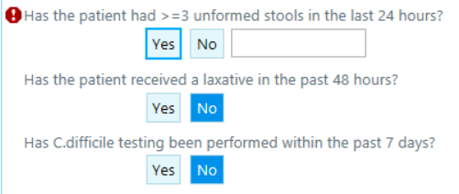
Take Action
Implement policies that support optimal antibiotic use
  Documentation of dose, duration, and indication
  Establish best practices for microbiology tests
    Don’t send urine culture or C. difficile stool tests to demonstrate “test of cure”
    Superficial wound swabs are not helpful
Prior to ordering a C. diff test, these questions must be answered
If a question is answered unfavorably, the test will not be ordered
Notes:
The Core Elements of Antibiotic Stewardship in Nursing Homes: Appendix A (cdc.gov)
Documentation of dose, duration, and indication. Specify the dose (including route), duration (i.e., start date, end date, and planned days of therapy), and indication, which includes both rationale (i.e., prophylaxis vs. therapeutic) and treatment site (i.e., urinary tract, respiratory tract), for every course of antibiotics. This bundle of antibiotic prescribing elements should be documented for both nursing home-initiated antibiotic courses as well as courses continued in the nursing home which were initiated by a transferring facility or emergency department. Documenting and making this information accessible (e.g., verifying indication and planned duration is documented on transfer paperwork) helps ensure that antibiotics can be modified as needed based on additional laboratory and clinical data and/or discontinued in a timely manner.1 CORE ELEMENTS OF ANTIBIOTIC STEWARDSHIP FOR NURSING HOMES 3 Establish best practices for use of microbiology testing. Inappropriate use of microbiology tests in nursing homes may drive unnecessary antibiotic treatment.2 For example, submitting urine cultures or C. difficile stool tests to demonstrate “test of cure” following clinical resolution after an appropriate treatment course may uncover asymptomatic colonization and drive additional unnecessary antibiotic exposure. Review the current protocols and laboratory testing practices to ensure that laboratory tests are used correctly in your facility (e.g., your facility should not require one or more negative C. difficile stool studies following completion of therapy for C. difficile infection). Identifying and reducing inappropriate use of laboratory testing may be a high-yield effort for improving antibiotic use and reducing other management costs. Develop facility-specific treatment recommendations. Facility-specific treatment recommendations, based on national guidelines3,4 and local susceptibilities can optimize antibiotic selection and duration, particularly for common indications for antibiotic use like pneumonia, urinary tract infection, and skin and soft tissue infections. Review the antibiotic agents available in the facility including an inventory of drugs accessible during off hours (e.g., emergency kit or overnight box) to ensure availability is not a barrier to use of preferred agents.
Policies that support optimal antibiotic use Ensure that current medication safety policies, including medication regimen review, developed to address Centers for Medicare and Medicaid Services (CMS) regulations15–17 are being applied to antibiotic prescribing and use. Broad interventions to improve antibiotic use Standardize the practices which should be applied during the care of any resident suspected of an infection or started on Nursing homes implement prescribing policies and change practices to improve antibiotic use. The introduction of new policies and procedures which address antibiotic use should be done in a step-wise fashion so staff become familiar with and not overwhelmed by new changes in practice. Prioritize interventions based on the needs of your facility and share outcomes from successful interventions with nursing staff and clinical providers. Below are brief descriptions of policy and practice changes. For more details, see Appendix A: Policy and practice actions to improve antibiotic use. 12 CENTERS FOR DISEASE CONTORL AND PREVENTION an antibiotic. These practices include improving the evaluation and communication of clinical signs and symptoms when a resident is first suspected of having an infection, optimizing the use of diagnostic testing, and implementing an antibiotic review process, also known as an “antibiotic time-out,” for all antibiotics prescribed in your facility. Antibiotic reviews provide clinicians with an opportunity to reassess the ongoing need for and choice of an antibiotic when the clinical picture is clearer and more information is available. Pharmacy interventions to improve antibiotic use Integrate the dispensing and consultant pharmacists into the clinical care team as key partners in supporting antibiotic stewardship in nursing homes. Pharmacists can provide assistance in ensuring antibiotics are ordered appropriately, reviewing culture data, and developing antibiotic monitoring and infection management guidance in collaboration with nursing and clinical leaders. Infection and syndrome specific interventions to improve antibiotic use Identify clinical situations which may be driving inappropriate courses of antibiotics such as asymptomatic bacteriuria or urinary tract infection prophylaxis18,19 and implement specific interventions to improve use

Slide 33
Take Action
Broad interventions to improve antibiotic use
  Develop and implement algorithms for the assessment of residents suspected of having infection
  Use a communication tool for residents suspected of having an infection
  Antibiogram
  Antibiotic Time Out
  Focus on durations of therapy
Notes:
The Core Elements of Antibiotic Stewardship in Nursing Homes: Appendix A (cdc.gov)
Develop and implement algorithms for the assessment of residents suspected of having an infection using evidence-based guidance.4,5 Utilize a communication tool for residents suspected of having an infection. Since attending physicians, nurse practitioners and/or physician assistants are not always available onsite in nursing homes, a significant amount of management of nursing home residents is mediated via phone interactions. Clinical providers must rely on the assessment and information conveyed to them by the front-line nursing staff to make diagnostic and treatment decisions. Barriers to effective telephone interactions between physicians and nurses, such as inadequate preparation or feeling rushed on the phone, 4 CENTERS FOR DISEASE CONTORL AND PREVENTION likely impact the quality of information exchange.6 Implementing structured communication tools to guide nursing-physician interactions (e.g., situation, background, assessment, recommendation, or SBAR protocol) may improve the quality of communication and the subsequent management process7,8 when an infection is suspected. Communication tools used to facilitate information when a resident is suspected of having an infection should include key pieces of the clinical history including new symptoms and complaints, physical exam findings (e.g., vital signs, pulse oximetry, localizing pain, etc.) and other relevant information (e.g., previous antibiotic exposure, previous culture and susceptibility results, current medications, and medication allergy history). Forms used for this information exchange could not only include information about the resident from nursing staff, but also options for how the offsite provider may want to manage the resident based on the information provided (e.g., hydrate and monitor, send further diagnostic tests, initiate treatment). In addition, any tools or forms utilized to improve communication should become part of the resident’s medical record to improve documentation of decision making. Develop and disseminate a facility-specific report of antibiotic susceptibility to clinical providers. Nursing homes should work with consultant laboratories to create a facilityspecific summary of antibiotic susceptibility patterns from the organisms commonly isolated in microbiology cultures. One example of a susceptibility summary is called an antibiogram. Antibiograms are tables developed by the microbiology laboratory showing the percent susceptibility for a panel of common bacteria tested against a panel of common antibiotics.9 Nursing home laboratories may have to tailor the antibiogram based on the facility’s diagnostic testing practices. For example, a nursing home antibiogram may only include organisms causing urinary tract infection if urine cultures are the most frequent test sent to the laboratory.10 Antibiograms may be updated every 12 to 24 months, based on the number of cultures submitted by a facility. Summaries of susceptibility patterns should be disseminated to frontline nursing staff, clinical providers and consultant pharmacists as an educational tool and to guide management decisions. Perform antibiotic “time outs.” Antibiotics are often started empirically in nursing home residents when the resident has a change in CORE ELEMENTS OF ANTIBIOTIC STEWARDSHIP FOR NURSING HOMES 5 physical or mental status while diagnostic information is being obtained. However, providers often do not revisit the selection of the antibiotic after more clinical and laboratory data (including culture results) become available.11,12 An antibiotic “time out” is a formal process designed to prompt a reassessment of the ongoing need for and choice of an antibiotic once more data is available including: the clinical response, additional diagnostic information, and alternate explanations for the status change which prompted the antibiotic start. Nursing homes should have a process in place for a review of antibiotics by the clinical team two to three days after antibiotics are initiated to answer these key questions: • Does this resident have a bacterial infection that will respond to antibiotics? • If so, is the resident on the most appropriate antibiotic(s), dose, and route of administration? • Can the spectrum of the antibiotic be narrowed or the duration of therapy shortened (i.e., de-escalation)? • Would the resident benefit from additional infectious disease/ antibiotic expertise to ensure optimal treatment of the suspected or confirmed infection? Reduce prolonged antibiotic treatment courses for common infections. A large study of antibiotic prescribing practices in nursing homes demonstrated that over 50% of antibiotic treatment courses extended beyond a week with no correlation with resident characteristics or type of infection being treated.13 Given the growing body of evidence that short courses of antibiotics are effective for common infections,14–16 interventions designed to decrease antibiotic duration among nursing home residents may reduce the complications and adverse events associated with antibiotic exposure.

Slide 34
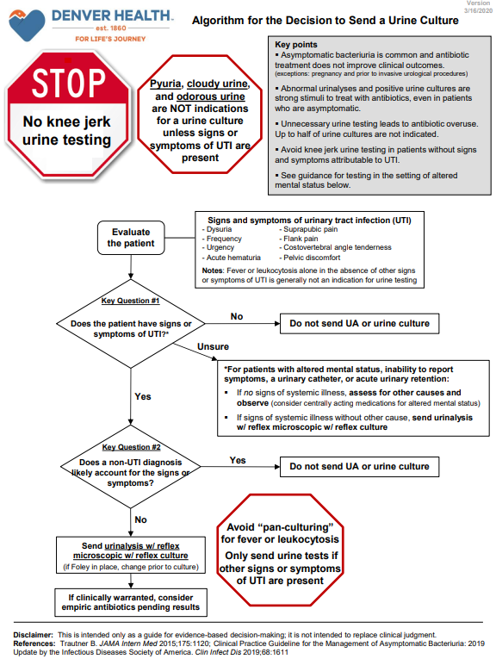

Slide 35
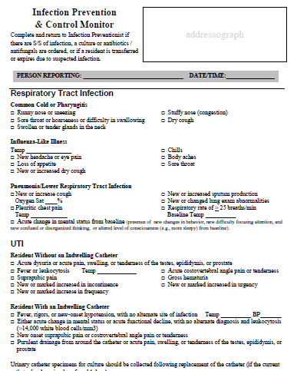

Slide 36
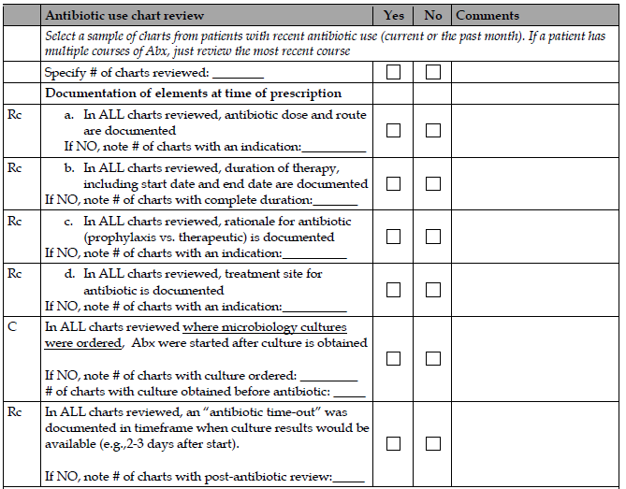
Take Action
Pharmacy interventions to improve antibiotic use
  Review of antibiotic prescriptions
  Establish standards on laboratory testing
  Review microbiology results
Notes:
The Core Elements of Antibiotic Stewardship in Nursing Homes: Appendix A (cdc.gov)
Review of antibiotic prescriptions as part of the drug regimen review (F-tag 428) for new medications is an existing practice for the 6 CENTERS FOR DISEASE CONTORL AND PREVENTION consultant pharmacist.17 Elements of the antibiotic review should include dosing and administration data, to ensure prescribers are making appropriate adjustments for renal function and potential drug interactions. Consultant pharmacists can also review indication and justification of use to verify that antibiotics are used in accordance with facility-specific treatment guidelines. Establish standards on laboratory testing to monitor for adverse drug events related to use of antibiotics and other high risk medications such as warfarin.18,19 Review of microbiology culture results by the consultant pharmacist can add an additional level of feedback to prescribing clinicians on initial antibiotic selection and subsequent modifications of therapy once data is available. Consultant pharmacists can be given a predefined set of criteria and/or guidance developed in collaboration with physician support20,21 to help optimize antibiotic use.

Slide 37
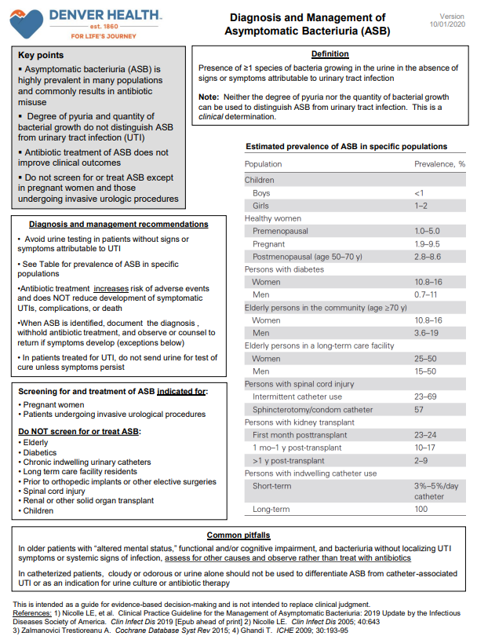
Take Action
Infection and syndrome specific interventions to improve antibiotic use
  Reduce antibiotic use in asymptomatic bacteriuria
  Reduce antibiotic prophylaxis for prevention of UTI
Notes:
The Core Elements of Antibiotic Stewardship in Nursing Homes: Appendix A (cdc.gov)
Reduce antibiotic use in asymptomatic bacteriuria (ASB). The prevalence of ASB, bacteriuria without localizing signs or symptoms of infection, ranges from 25% to 50% in non-catheterized nursing home residents and up to 100% among those with long-term urinary catheters.22 Antibiotic use for treatment of ASB in nursing home residents does not confer any long-term benefits in preventing symptomatic urinary tract infections (UTI) or improving mortality, and may actually increase the incidence of adverse drug events and result in subsequent infections with antibiotic-resistant pathogens.23 The unreliable clinical assessment for infections in nursing home residents coupled with the diagnostic uncertainties in differentiating ASB from infection contributes greatly to inappropriate antibiotic use and its related complications. Suspected UTIs account for 30% to 60% of antibiotic prescriptions in nursing homes.24 Implementing a set of diagnostic testing and management algorithms to help providers differentiate ASB from symptomatic UTI has been shown to reduce inappropriate antibiotic use for ASB.25,26 CORE ELEMENTS OF ANTIBIOTIC STEWARDSHIP FOR NURSING HOMES 7 Reduce antibiotic prophylaxis for prevention of UTI. Surveys of antibiotic use have shown that UTI prophylaxis accounts for a significant proportion of antibiotic prescriptions.27 Very few studies support antibiotic use for UTI prophylaxis, especially in older adults, and many studies have shown this antibiotic exposure increases risk of side effects and resistant organisms.23 Therefore, efforts to educate providers on the potential harm of antibiotics for UTI prophylaxis could reduce unnecessary antibiotic exposure and improve resident outcomes. Optimize management of nursing home-associated pneumonia. Limited access to high-quality diagnostic testing makes the differentiation of viral and bacterial causes of lower respiratory tract infections very difficult in nursing home residents.28 Implementation of algorithms for diagnosis and management of nursing home-associated pneumonia may be valuable in helping guide decision-making about use of antibiotics and need for hospital transfer.29–31 Optimize use of superficial cultures for management of chronic wounds. Although obtaining specimens for wound culture can help guide antimicrobial treatment, reliance on superficial swab cultures alone may drive inappropriate or unnecessary antibiotic use. Superficial wound swabs cannot differentiate bacterial colonization from infection and there may be a lack of correlation between organisms identified by superficial swab cultures compared with deep tissue cultures.32 Reviewing the indications for obtaining cultures in residents with chronic wounds (e.g., presence of purulent drainage) and assessing the type of specimen submitted for culture (e.g., superficial swab vs. tissue specimen from debrided wound base) may identify opportunities for improving antibiotic use in residents with chronic wounds.

Slide 38
Tracking and Reporting Antibiotic Use
Process measures
  Example: Proportion of antibiotic orders that had documented indication
Antibiotic use measures
  Example: Days of therapy/1000 patient or resident days
Antibiotic outcome measures
  Adverse events including CDI and antibiotic resistance
  Cost
Notes:
Process measures: Tracking how and why antibiotics are prescribed Perform reviews on resident medical records for new antibiotic starts to determine whether the clinical assessment, prescription documentation and antibiotic selection were in accordance with facility antibiotic use policies and practices. When conducted over time, monitoring process measures can assess whether antibiotic prescribing policies are being followed by staff and clinicians. Antibiotic use measures: Tracking how often and how many antibiotics are prescribed Track the amount of antibiotic used in your nursing home to review patterns of use and determine the impact of new stewardship interventions. Some antibiotic use measures (e.g., prevalence surveys) provide a snap-shot of information; while others, like 14 CENTERS FOR DISEASE CONTORL AND PREVENTION nursing home initiated antibiotic starts and days of therapy (DOT) are calculated and tracked on an ongoing basis.20,21 Selecting which antibiotic use measure to track should be based on the type of practice intervention being implemented. Interventions designed to shorten the duration of antibiotic courses, or discontinue antibiotics based on post-prescription review (i.e., “antibiotic time-out”), may not necessarily change the rate of antibiotic starts, but would decrease the antibiotic DOT. Antibiotic use data from nursing homes to improve antibiotic stewardship efforts is important both for individual facility improvements and for public health action. Expansion of electronic health records in nursing homes will allow for facilities to obtain systems which integrate pharmacy and laboratory data and make antibiotic use and resistance data to inform stewardship efforts more accessible to facility staff and leadership. CDC is working closely with many nursing home partners including providers, long-term care pharmacies, and professional organizations, to develop an Antibiotic Use (AU) reporting option for nursing homes within the CDC’s National Healthcare Safety Network (NHSN). The NHSN AU option allows for standardized antibiotic use data, submitted electronically, to be aggregated and summarized for developing facility-adjusted national benchmarks. Antibiotic outcome measures: Tracking the adverse outcomes and costs from antibiotics Monitor clinical outcomes such as rates of C. difficile infections, antibiotic-resistant organisms or adverse drug events to demonstrate that antibiotic stewardship activities are successful in improving patient outcomes. Nursing homes already tracking these clinical outcomes for their infection prevention program can submit data on C. difficile and selected antibiotic-resistant bacteria, such as methicillin-resistant Staphylococcus aureus (MRSA) and carbapenem-resistant Enterobacteriaceae (CRE) into the CDC’s NHSN Laboratory-identified event reporting module for long-term care facilities

Slide 39
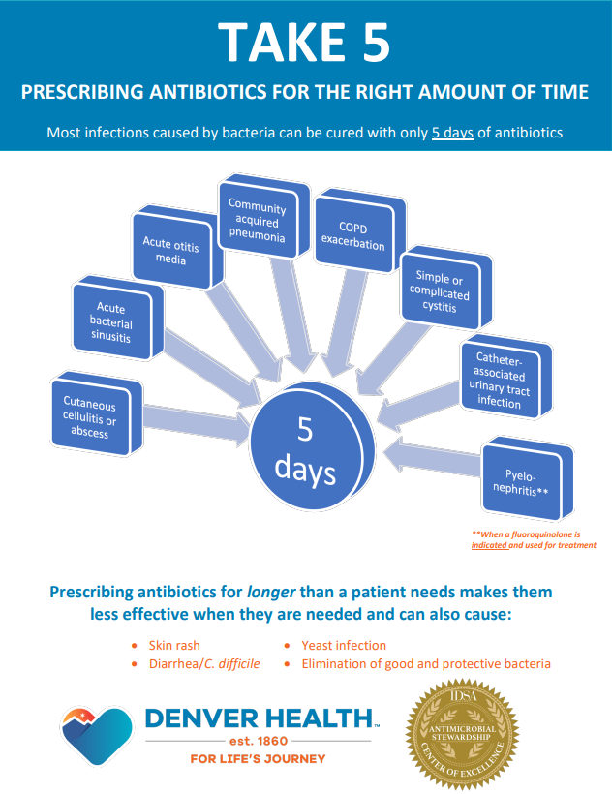
Education
Target providers, nurses, consulting pharmacists
Flyers, pocket-guides, newsletters, electronic communications
  Face-to-face interactive sessions have strongest evidence
Provide feedback to providers
Engage residents and family members
Notes:
Nursing homes provide antibiotic stewardship education to clinicians, nursing staff, residents and families. Effective educational programs address both nursing staff and clinical providers on the goal of an antibiotic stewardship intervention, and the responsibility of each group for ensuring its implementation.3,22 There are a variety of mechanisms for disseminating antibiotic education to nursing home staff including flyers, pocket-guides, newsletters or electronic communications; however, interactive academic detailing (e.g., face-to-face interactive workshops) has the strongest evidence for improving medication prescribing practices.23 Nursing homes sustain improvements by incorporating both education and feedback to providers. One nursing home antibiotic stewardship intervention demonstrated a sustained reduction in antibiotic use for two years after the intervention by linking education with feedback on physician prescribing practices.24 Another study showed a 64% reduction in inappropriate antibiotic use (i.e., prescriptions which did not adhere to guidelines), by providing feedback on individual physician prescribing practices and adherence to the guidelines over 12 months.25 Nursing homes engage residents and their family members in antibiotic use and stewardship educational efforts to ensure clinicians have their support to make appropriate antibiotic use decisions. Working with residents and families will reduce the perception that their expectations may be a barrier to improving antibiotic use in nursing homes.26,27

Slide 40
Antibiotic Challenges in Nursing Homes
Lack of funding and facility resources
Challenges associated with proper diagnosis and treatment
  Prescribers rely on assessments made by someone else
    67% were ordered via phone
  Residents' ability to communicate symptoms
Limited documentation of rationale for antibiotics
  43% of NH-initiated antibiotics had no documentation of infection
Lack of trained ID physicians and pharmacists
Difficulty obtaining and interpreting lab and diagnostic data
Resident, family, NH staff requests
Richards et al. J Am Med Dir Assoc 2005;6(2):109-12.
Notes:
Richards et al. J Am Med Dir Assoc 2005;6(2):109-12.
Nice slide on this: slide 20 Antibiotic Stewardship in Long-Term Care and the CDC Core Elements (state.mn.us)
Lack of funding and facility resources ie micro lab, radiology

Slide 41
Effective interventions
  Diagnostic/treatment guidelines
  Personalized feedback to providers on prescribing patterns
  Education
  Prospective audit with prescribing recommendations
  Infectious Diseases consultation
  Telemedicine
Rhee S. Infect Dis Clin N Am 2014; 28:237
Beaulac K. ICHE 2016 ;37:433
Jump RL. ICHE 2012; 33:1185
Notes:
Interventions shown to improve antibiotic use in LTCFs – slide 24 from Tim

Slide 42
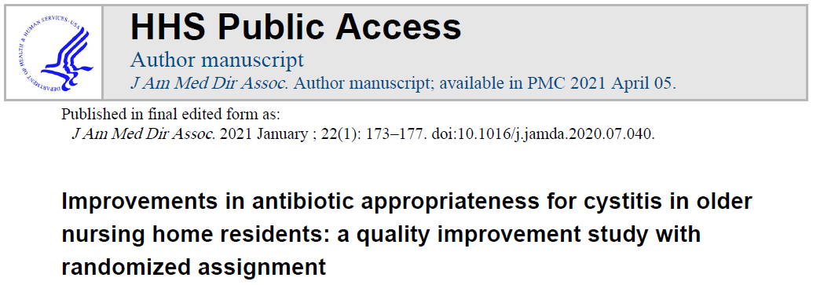
25 nursing homes randomized to intervention or usual care
  Intervention: webinar, pocket cards, order sets
21% reduction in inappropriate antibiotic prescribing
  Statistically significant improvement in prescribed duration of therapy (p=0.039)
Hanlon JT, et al. J Am Med Dir Assoc. 2021;22(1):173-77.
Notes:
Hanlon JT, et al. J Am Med Dir Assoc. 2021;22(1):173-77.
We used a multifaceted educational intervention consisting of a: 1) one-hour webinar presented by a physician, pharmacist and nurse that provided information about the project and the consensus recommendations; 2) pocket sized educational cards with the consensus diagnosis and treatment recommendations and 3) physician order set forms for the diagnosis and treatment of probable cystitis

Slide 43
Starting an Antibiotic Stewardship Program
Leader – motivated local champion is critical
Team members
  Pharmacist
  Medical staff representative
  Nursing staff representative
  Infection control
  Administrative leadership
Adapt/implement strategies appropriate for:
  Resources
  Facility
  Infection types
Notes:
Tim’s slide

Slide 44
Starting an Antibiotic Stewardship Program
CDC Core Elements of Antibiotic Stewardship for Nursing Homes
  Step-wise fashion – start with 1-2 activities and gradually add new strategies
  Policies that support optimal antibiotic prescribing
  Broad interventions
  Pharmacy interventions
  Infection specific interventions
Notes:
Tim’s slide
Step wise fashion as to not overwhelm and to allow staff to become familiar with the changes
Appendix A https://www.cdc.gov/longtermcare/pdfs/core-elements-antibiotic-stewardship-appendix-a.pdf

Slide 45
Sustainability of ASP in Nursing Home
Requires explicit, ongoing leadership support
Partnerships with an external antibiotic stewardship expert and fostering internal interprofessional collaborations
Consistent education and training for all staff
Seshadri S, et al. ICHE 2021;42:440-47
Notes:
Seshadri S, et al. ICHE 2021;42:440-47
Doi:10.1017/ice.2020.1217
https://www.cambridge.org/core/journals/infection-control-and-hospital-epidemiology/article/there-is-no-one-to-pick-up-the-pieces-sustainability-of-antibiotic-stewardship-programs-in-nursing-homes/0DEBCCA57A5A7CC158D0C4BDBFEA0A50/share/31b57085bbc03cf5fc69e58e1d709f1356ecb2ed
Explicit leadership support: Have ASP champion report to medical director with authority to cross interprofessional boundaries, create ASP Team (medical director, pharmacists, IP, nurse), define roles of ASP team, rotate role of champion, vocally support ASP champ, be physically in trenches with team, listen to and address ASP concerns and plans, plan for regular interactions between medical director and ASP champ, provide all available resources (eg time, personnel) for AS tasks, engage in discussions on how to cross rigid interprofessional boundaries, support AS education, track and analyze data, and problem solve.
Partnerships- external and internal
Hire AS expert as consultant if able OR collaborate with other NHs to obtain external support, develop peer-learning modules, and strategies to overcome challenges OR pool resources with other NH to creaste an AS collaborateive to develop guidelines, eduate, and problem solve
Internal: Review interprofessional boundarys, seek input from all professionals on barriers to communication, share AS info and data with all NH employees, promore dialogue on AS with all employees across professions and review an implement best practices on AS communication
Consistent AS Education:
Idenfity AS education team, define roles and responsibilities, and assign AS ed coordinator, de-centralize education, seek input from all professionals on barriers to education and strategies to overcome the barriers, have multiple formal and informal, inperson ed opportunitis, design each ed module to align with the role of the staff member, bring ed to the staff by providing regular 2 min AS education and tips on units to save time, promote an “each one teach one” module with teachers across hierarchy eg nurse educator teaches nurse managers AS and how to teach LPNs, LPNs learn AS and how to teach CNAs, CNAs receive education on AS and how to teach families

Slide 46
Summary
Antibiotic resistance is a threat to our patients and residents in LTCF and NH
Antibiotic exposure is the greatest risk factor for antibiotic resistance
High rates of antibiotic misuse are seen in LTCF and NH
Implementation of antibiotic stewardship programs is a national priority in these settings
Start slowly – identify 1-2 opportunities to improve antibiotic use and measure the impact of those changes

Slide 47
Resources
National Quality Partners Playbook™: Antibiotic Stewardship in Post-Acute and Long-Term Care - https://memberstore.qualityforum.org/products/national-quality-partners-playbook%E2%84%A2-antibiotic-stewardship-in-post-acute-and-long-term-care
AHRQ Nursing Home AMS Guide: https://www.ahrq.gov/nhguide/index.html
AHRQ (Agency for Healthcare Research and Quality) Nursing Home AMS Guide. Examples: https://qsep.cms.gov/data/251/AntibioticStewardshipProgramResourcesCMS508.pdf
Core Elements CDC: https://www.cdc.gov/antibiotic-use/core-elements/nursing-homes.html
AMS training courses and certificates:
  SIDP - https://www.proce.com/SIDP-LTC
  MAD-ID - https://mad-id.org/antimicrobial-stewardship-programs/
CDC Be Antibiotics Aware – https://www.cdc.gov/antibiotic-use/week/index.html
Infectious Diseases Society of America -
https://www.idsociety.org/public-health/antimicrobial-resistance/antimicrobial-resistance/
Society for Healthcare Epidemiology of America (SHEA)
https://shea-online.org/index.php/practice-resources/priority-topics/antimicrobial-stewardship
Notes:
National Quality Partners Playbook™: Antibiotic Stewardship in Post-Acute and Long-Term Care - https://memberstore.qualityforum.org/products/national-quality-partners-playbook%E2%84%A2-antibiotic-stewardship-in-post-acute-and-long-term-care. Developed with input from 50 key experts including several SIDP members. The playbook offers practical strategies and useful resources for implementing high-quality antibiotic stewardship programs in post-acute and long-term care facilities
AHRQ Nursing Home AMS Guide: https://www.ahrq.gov/nhguide/index.html – includes toolkits to help nursing homes optimize abx use, toolkits to help start and maintain a program
AHRQ (Agency for Healthcare Research and Quality) Nursing Home AMS Guide. Examples: https://qsep.cms.gov/data/251/AntibioticStewardshipProgramResourcesCMS508.pdf

Slide 48
Antibiotic Stewardship in Long-Term Care
Kati Shihadeh, PharmD, BCIDP
Infectious Diseases Pharmacy Specialist
Denver Health Medical Center

