Slide 1
New Medications for LDL-C Lowering
Joseph Saseen, PharmD
Professor and Associate Dean for Clinical Affairs
University of Colorado Anschutz Medical Campus

Slide 2
DISCLOSURES
Dr. Joseph Saseen has no relevant financial relationships with ineligible companies to disclose.
This continuing education activity is managed by Innovatix* and AffinityCE. Innovatix* is accredited by the Accreditation Council for Pharmacy Education as a provider of continuing pharmacy education.
Innovatix* and AffinityCE as well as planners and reviewers have no relevant financial relationships with ineligible companies to disclose. Neither Innovatix* nor Affinity CE support or endorse any product or service mentioned in this activity. Disclosure will be made when a product is discussed for an unapproved use.
The material presented for this session has been reviewed by the Innovatix* Institute CE Committee and AffinityCE and has been found to be free of any content influence or commercial bias.
Commercial Support was not received for this activity.
*Innovatix now operates under Premier Alternate Site Programs

Slide 3
Objectives
1. Outline ACC/AHA guideline recommendations for management of hypercholesterolemia
2. Discuss the prevalence and management of statin associated muscle symptoms
3. Describe new LDL-C lowering medications (including evinacumab, bempedoic acid, and inclisiran).
4. Identify patients that are candidates for further LDL-C lowering despite maximally tolerated statin therapy

Slide 4
Burden of CVD in the United States (US)
CVD is the leading cause of death in the United States
The indirect and direct cost of CVD for 2014 to 2015 was $351.2 billion
By 2035, the projected total cost of CVD will approach $1.1 trillion
ASCVD, atherosclerotic cardiovascular disease; CVD, cardiovascular disease.
Virani SS, et al. Circulation. 2020;141(9):e139-e596.

Slide 5
Hypercholesterolemia in the US
Strong evidence proves its contribution to ASCVD
28.5 million adults have a total cholesterol ≥240 mg/dL
Cholesterol
Dominant form of atherogenic cholesterol, the primary cause of ASCVD
LDL-C
Clinical Trials
LDL-C−lowering medication in high-risk patients is proven to reduce ASCVD
Grundy SM, et al. Circulation. 2019;139(25):e1082-e1143; Virani SS, et al. Circulation. 2020;141(9):e139-e596.

Slide 6
Importance of Lowering LDL-Cholesterol
Cholesterol Treatment Trialists Meta-Analysis
30%
25%
TNT
Statin vs. control
(21 trials)
20%
More vs.
Less
(5 trials)
Proportional reduction in
MVE rate (95% CI)
22% risk reduction per mmol/L
(38.67 mg/dL)
of LDL-C lowering
IDEAL
15%
PROVE-IT
10%
A to Z
5%
SEARCH
0%
0.0
0.5
1.0
Mean LDL cholesterol difference between treatment groups (mmol/L)
Baignet C, et al. Lancet. 2010;376(9753):1670-1681; Cholesterol Treatment Trialists’ Collaboration. www.cttcollaboration.org/efficacy-web-page

Slide 7
Residual Cardiovascular Risk in Statin-Treated Patients in Secondary Prevention
Scandinavian Simvastatin Survival Study Group. Lancet. 1994;344:1383-1389. LIPID Study Group. N Engl J Med. 1998;339:1349-1357. Schwartz GC, et al. JAMA. 2001;285:1711-1718; Cannon CP, et al. N Engl J Med. 2015;372(25):2387-2397; Sabatine MS, et al. N Engl J Med. 2017;376(18):1713-1722; Schwartz GG, et al. N Engl J Med. 2018;379(22):2097-2107.
Notes:
ARR 2% for all (modest drop in LDL of 15 mg/dL)
RRR 15% PCSK9i
Key Concept: At the time of publication of the 2013 ACC/AHA guidelines there were no available large RCTs of non-statin therapies for LDL-C lowering. However, recent evidence with ezetimibe, evolocumab, and alirocumab support the benefits of the addition of non-statin therapies to maximally tolerated statin in appropriate high-risk patients.

Slide 8
AHA/ACC/AACVPR/AAPA/ABC/ACPM/ADA/AGS/APhA/ASPC/ NLA/PCNA Guideline on the Management of Blood Cholesterol
2018 Cholesterol Guideline Writing Committee
Alison L. Bailey, MD, FACC, FAACVPR†
Craig Beam, CRE*
Kim K. Birtcher, MS, PharmD, AACC, FNLA‡
Roger S. Blumenthal, MD, FACC, FAHA, FNLA§
Lynne T. Braun, PhD, CNP, FAHA, FPCNA, FNLA║
Sarah de Ferranti, MD, MPH*
Joseph Faiella-Tommasino, PhD, PA-C¶
Daniel E. Forman, MD, FAHA**
Ronald Goldberg, MD††
Paul A. Heidenreich, MD, MS, FACC, FAHA‡‡
Mark A. Hlatky, MD, FACC, FAHA*
Daniel W. Jones, MD, FAHA§
Donald Lloyd-Jones, MD, SCM, FACC, FAHA*
Nuria Lopez-Pajares, MD, MPH§§
Chiadi E. Ndumele, MD, PhD, FAHA*
Carl E. Orringer, MD, FACC, FNLA║║
Carmen A. Peralta, MD, MAS*
Joseph J. Saseen, PharmD, FNLA, FAHA¶¶
Sidney C. Smith, Jr, MD, MACC, FAHA*
Laurence Sperling, MD, FACC, FAHA, FASPC***
Salim S. Virani, MD, PhD, FACC, FAHA*
Joseph Yeboah, MD, MS, FACC, FAHA†††
*ACC/AHA Representative. †AACVPR Representative. ‡ACC/AHA Task Force on Clinical Practice Guidelines Liaison. §Prevention Subcommittee Liaison. ║PCNA Representative. ¶AAPA Representative. **AGS Representative. ††ADA Representative. ‡‡PM Representative. §§ACPM Representative. ║║NLA Representative. ¶¶APhA Representative. ***ASPC Representative. †††ABC Representative
Grundy SM, et al. Circulation. 2019;139(25):e1082-e1143.

Slide 9
Four Statin Benefit Groups
Secondary
Prevention
Primary
Prevention
Clinical ASCVD
LDL-C
≥190 mg/dL
Diabetes type 1 or 2, age 40-75 years
Increased ASCVD risk, age 40-75 years
1
2
3
4
Grundy SM, et al. Circulation. 2019;139(25):e1082-e1143.

Slide 10
Polling Question #1
A 70-year-old with a history of a recent MI is not on lipid lowering medication. Which of the following agents is recommended according to the 2018 AHA/ACC cholesterol guidelines?
Atorvastatin 10 mg daily
Ezetimibe 10 mg daily
Rosuvastatin 20 mg daily
Simvastatin 40 mg daily
Notes:
Answer is C

Slide 11
Secondary Prevention of ASCVD
No
Very High-Risk
Yes
Age ≤75 yr
Age >75 yr
High-intensity statin
High-intensity statin
If on maximal statin and LDL-C ≥70 mg/dL adding ezetimibe
If PCSK9i is considered, add ezetimibe to maximal statin first
If high-intensity not tolerated use moderate-intensity statin
If on maximal statin and
LDL-C ≥70 mg/dL adding ezetimibe
Moderate or high-intensity statin
Continuing high-intensity statin
If on clinically judged-maximal LDL-C lowering medication and LDL-C ≥70 mg/dL
(or non-HDL-C ≥100 mg/dL)
adding a PCSK9 monoclonal antibody
Grundy SM, et al. Circulation. 2019;139(25):e1082-e1143.

Slide 12
Very High-Risk ASCVD
Major ASCVD Events
Recent acute coronary syndrome (past 12 mo) Prior myocardial infarction (other than recent ACS event listed above) Prior ischemic stroke Symptomatic peripheral arterial disease
History of multiple major ASCVD events or
1 major ASCVD event and multiple
high-risk
conditions
High-Risk Conditions
Age ≥65 yr Heterozygous familial hypercholesterolemia Prior coronary revascularization outside of the major ASCVD event(s) Diabetes mellitus Hypertension Chronic kidney disease (eGFR 15-59 mL/min/1.73 m²) Current smoking LDL-C ≥100 mg/dL despite maximally tolerated statin and ezetimibe History of congestive heart failure
Grundy SM, et al. Circulation. 2019;139(25):e1082-e1143.

Slide 13
Most Secondary Prevention Patients are Categorized as Very High-Risk
US adults with health insurance in the MarketScan database
16,334 patients with major ASCVD events
Muntner P, et al. Cardiovascular Drugs and Therapy (2021). https://doi.org/10.1007/s10557-021-07167-1
Notes:
Muntner P, et al. Cardiovascular Drugs and Therapy.March 2021; https://doi.org/10.1007/s10557-021-07167-1
Evaluating a Simple Approach to Identify Adults Meeting the 2018 AHA/ACC Cholesterol Guideline Definition of Very High Risk for Atherosclerotic Cardiovascular Disease.
“Conclusion: 90% of patients with a recent ACS, history of MI other than recent ACS, history of ischemic stroke, or symptomatic PAD in the current study met the 2018 AHA/ACC cholesterol definition for very high risk for future ASCVD events. The ASCVD incidence rate was sim- ilar among patients with a history of a major ASCVD event and those who met the 2018 AHA/ACC cholesterol guideline definition for very high risk. These data suggest that patients with a history of a major ASCVD event can be assumed to have very high risk for future events without applying addi- tional risk stratification algorithms.”

Slide 14
Primary Prevention
LDL-C ≥190 mg/dL
Diabetes, age 40-75 yrs
Age 40-75 yr and LDL-C 70-189 mg/dL without diabetes
10-yr ASCVD risk begins discussion
Age >75 yr:
Clinical assessment, risk discussion
<5%
Low-Risk
5 to 7.4%
Borderline-Risk
7.5 to 19.9%
Intermediate-Risk
≥20%
High-Risk
High-intensity statin
Moderate-intensity statin
Emphasize lifestyle
If Risk Enhancers, risk discussion regarding
moderate-intensity statin
If risk estimate and enhancers favor treatment, moderate-intensity statin to reduce LDL-C 30-49%
High-intensity statin to reduce LDL-C ≥50%
Risk assessment to consider high-intensity statin
Grundy SM, et al. Circulation. 2019;139(25):e1082-e1143.

Slide 15
Risk Enhancing Factors that Favor Treatment
Family history of premature ASCVD
LDL-C 160–189 mg/dL or non–HDL-C 190–219 mg/dL
Metabolic syndrome
Chronic Kidney Disease
eGFR 15–59 mL/min/1.73m2
Chronic inflammatory conditions (e.g., rheumatoid arthritis, HIV)
Premature menopause (< 40 yr), pregnancy-associated conditions that increase later ASCVD risk (e.g., preeclampsia)
High-risk race/ethnicities (e.g., South Asian)
Persistently elevated, primary hypertriglyceridemia (≥175 mg/dL)
If measured:
hsCRP ≥2.0 mg/L, Lp(a) ≥50 mg/dL, apoB ≥130 mg/dL, or ABI <0.9
Grundy SM, et al. Circulation. 2019;139(25):e1082-e1143.

Slide 16
Clarifying LDL-C Terminology
Goal
% LDL-C lowering from baseline in response to therapy
≥50% when a high-intensity statin is recommended
Threshold
LDL-C value if at or above, clinician should consider starting or intensifying LDL-C−lowering therapy
70 mg/dL for clinical ASCVD
Applies to all 4 statin benefit groups
30%-49% when a moderate-intensity statin is recommended
100 mg/dL for LDL-C ≥190 mg/dL at baseline
Grundy SM, et al. Circulation. 2019;139(25):e1082-e1143.

Slide 17
Statin Intensity
High-intensity | Moderate-intensity
Daily dose that provides ≥50% LDL-C lowering | Daily dose that provides 30% to 49% LDL-C lowering
Atorvastatin 40-80 mg Rosuvastatin 20-40 mg | Atorvastatin 10-20 mg Rosuvastatin 5-10 mg Simvastatin 20-40 mg Pravastatin 40-80 mg Lovastatin 40-80 mg Fluvastatin 80 mg Pitavastatin 1-4 mg
Grundy SM, et al. Circulation. 2019;139(25):e1082-e1143.

Slide 18
Limitations of Statin Therapy
Inadequate treatment despite proven clinical benefits
Statin-associated muscle symptoms (SAMS)
Grundy SM, et al. Circulation. 2019;139(25):e1082-e1143.

Slide 19
What Is Statin Intolerance?
…defined as the occurrence of (1) adverse symptoms perceived by the patient to be unacceptable, and/or (2) laboratory abnormalities suggesting undue risk, which are attributed to statin therapy and lead to its discontinuation. For practical purposes, descriptions regarding acceptability of symptoms, attributability to statin therapy, and the degree of intolerance need to be better defined.
The American College of Cardiology (ACC) Statin Intolerance App can assist clinicians
Stulc T, et al. Curr Atheroscler Rep. 2015;17(12):69. American College of Cardiology. Statin Intolerance App. Accessed January 2, 2021. www.acc.org/statinintoleranceapp

Slide 20
Polling Question #2
Which of the following is the estimated incidence of statin associated muscle symptoms using real world observational data?
<5%
5-10%
20-20%
>50%
Notes:
Answer is B

Slide 21
Statin-Associated Muscle Symptoms (SAMS)
Type | Frequency | Predisposing Factors
Myalgia CK is normal with muscle pain, aches | Infrequent (1%-5%) in clinical trials; Frequent (5%-10%) in observational studies and clinical setting | Age, female, low BMI, interacting medications, comorbidities (HIV, renal, liver, thyroid, preexisting myopathy), Asian descent, excess alcohol, high levels of physical activity, trauma
Myositis/Myopathy CK >3 x ULN with concerning symptoms/objective weakness | Rare | ?
Rhabdomyolysis CK >10 x ULN with renal injury [acute serum creatinine increase ≥0.5 mg/dL]) | Rare | ?
CK, serum creatine kinase; HIV, human immunodeficiency virus; ULN, upper limit of normal (from laboratory range).
Grundy SM, et al. Circulation. 2019;139(25):e1082-e1143.

Slide 22
Managing SAMS and Statin Intolerance
Rule out secondary causes
Continue therapy if patient is willing; SAMS is not a drug allergy
If patient unwilling to continue current statin, use a different statin or a lower dose of the same statin; adding a nonstatin may be needed
May use a long half-life statin and an unapproved infrequent dosing schedule (eg, rosuvastatin 5–10 mg one to three times a week)
Use nonstatin(s) to lower LDL-C for patients completely unable to use a statin or cannot use the recommended statin intensity
Grundy SM, et al. Circulation. 2019;139(25):e1082-e1143. Keating AJ, et al. Ann Pharmacother. 2013;47(3):398-404..

Slide 23
Statin Rechallenge Worthwhile in Patients With Reports of Statin Associated Side Effects
Cleveland Clinic experience
1,605 patients referred to cardiology clinic for statin intolerance
72.5% were able to tolerate statin for 31-month follow-up
Brigham and Women’s Hospital/Massachusetts General Hospital
6,579 patients rechallenged with statin after statin-related event
92.5% still taking statin 12-months after statin-related event
Literature review
575 patients with statin-associated muscle symptoms
70% could tolerate intermittent or non-daily dosing
70% of patients with SAMS can tolerate an intermittent dosing strategy
Mampuya WM, et al. Am Heart J 2013;166:597-603. Zhang H, et al. Ann Intern Med 2013;158:526-534. Keating AJ, et al. Ann Pharmacother. 2013;47(3):398-404.
Notes:
May we use this instead?

Slide 24
The Nocebo Effect
Is associated with the person's prior expectations of adverse effects from treatment as well as with conditioning in which the person learns from prior experiences to associate a medication with certain somatic symptoms.
Nocebo comes from the Latin noceo, to harm and means
“I shall harm”
whereas placebo means
“I shall please”

Slide 25
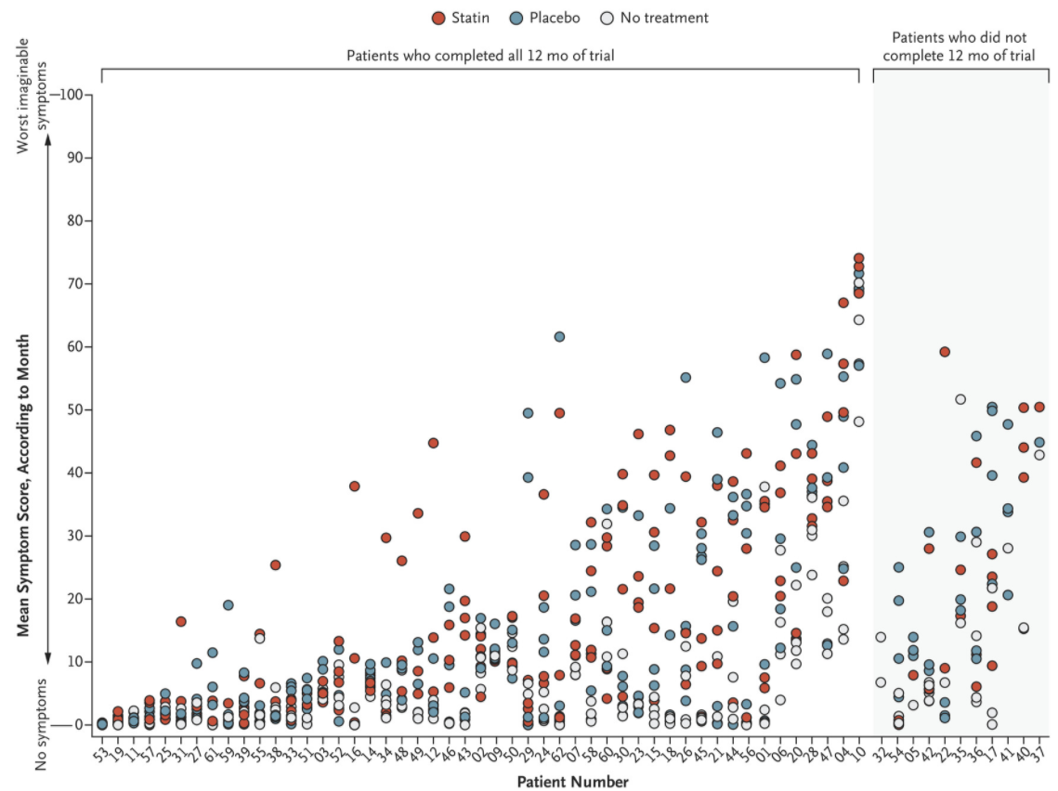
N-of-1 Trial of a Statin, Placebo, or No Treatment to Assess Side Effects
60 patients received four atorvastatin 20 mg bottles, four placebo bottles, and four empty bottles
Each bottle was used for 1-month according to a random sequence
Patients report symptom intensity daily
0 (no symptoms) to 100 (worst imaginable)
Mean symptom intensity:
8.0 during no-tablet months
15.4 during placebo
16.3 during statin months
Wood FA, et al. N Engl J Med 2020; 383:2182-2184.

Slide 26
2018 AHA/ACC/Multisociety Cholesterol Guideline Recommends Assessing Adherence and Response to Therapy
Measurement of fasting lipids should be assessed
4–12 weeks after statin initiation or dose adjustment, and
Every 3–12 months thereafter
Grundy SM, et al. Circulation. 2019;139(25):e1082-e1143.
Notes:
It is important to measure LDL-C after initiating or changing therapy to assess adherence and response to therapy.

Slide 27
Interpatient Variability in Statin Response
Event Rate/ 1000 person-years
Individuals (%, n=7,856)
LDL-C reduction
LDL-C reduction
Ridker PM, et al. Eur Heart J. 2016;37(17):1373-1379.

Slide 28
Polling Question #3
Which of the following non-statin medications lowers LDL-C the most?
Alirocumab
Bempedoic Acid
Ezetimibe
Colesevelam
Notes:
Answer is D

Slide 29
Drugs Affecting Lipoprotein Metabolism
 | LDL-C ↓ | HDL-C ↑ | TG ↓
Statins | 18-55% | 5-15% | 7-30%
Bile acid sequestrants | 15-30% | 3-5% | 0-10%↑
Nicotinic acid | 5-25% | 15-35% | 20-50%
Fibric acid derivatives | 5%↓ to 20%↑ | 10-20% | 20-50%
Ezetimibe | 13-20% | 3-5% | 5-11%
Omega-3 fatty acids | 6%↓ to 25%↑ | 5%↓ to 7%↑ | 19-44%
PCSK9 monoclonal antibody | 40-72% | 0-10% | 0-17%
Bempedoic acid | 15-17% | 6%↓ | 2%↓ to 6%↑
Inclisiran (coming soon) | Over 50%
Jacobson TA et al. J Clin Lipidol. 2014; 8:473-88. Shimada YJ and Cannon CP. European Heart Journal doi:10.1093/eurheartj/ehv174
Nexletol (bempedoic acid) [package insert]. Ann Arbor,MI: Esperion Therapeutics, Inc.; 2020

Slide 30
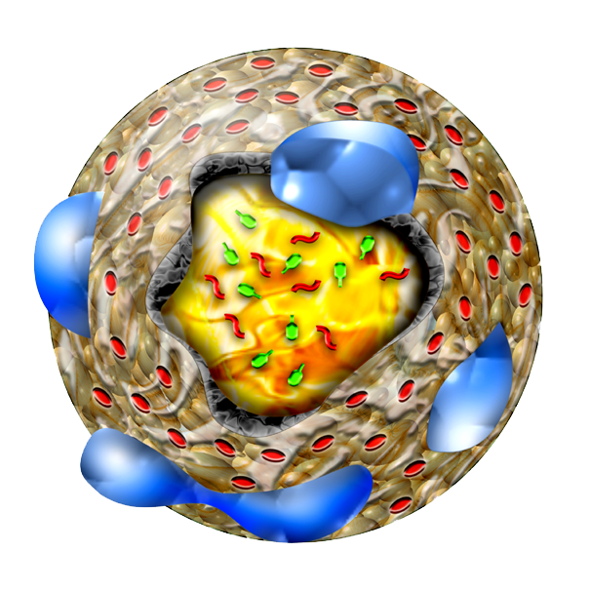
PCSK9 Inhibitors (PCSK9i)
LDL Receptor (LDL-R)
LDL Particle
LDL Receptor (LDL-R)
LDL Particle
PCSK9
Alirocumab and evolocumab are fully human monoclonal antibodies against PCSK9
Endocytosis
Clathrin-coated vesicle
Clathrin-coated vesicle
Endosome
Lysosome
Web Supplement to the 2018 AHA/ACC/Multisociety Guideline on the Management of Blood Cholesterol. Published 2018. Accessed January 2, 2021. http://jaccjacc.acc.org/Clinical_Document/Cholesterol_GL_Web_Supplement.pdf

Slide 31
Other Insights From ODYSSEY OUTCOMES: Background Statin Therapy
Incidence of Major Adverse CV Events
 | Alirocumab (%) | Placebo (%) | HR (95% CI)
High-Intensity (88.8%) | 9.5 | 11.8 | 0.88 (0.80-0.96)
Moderate/ Low-Intensity (8.7%) | 7.5 | 10.7 | 0.68 (0.49-0.94)
No Statin (2.4%) | 18.0 | 26.0 | 0.65 (0.44-0.97)
Diaz R, et al. Eur J Prev Cardiol. 2021;28(1):33-43.

Slide 32
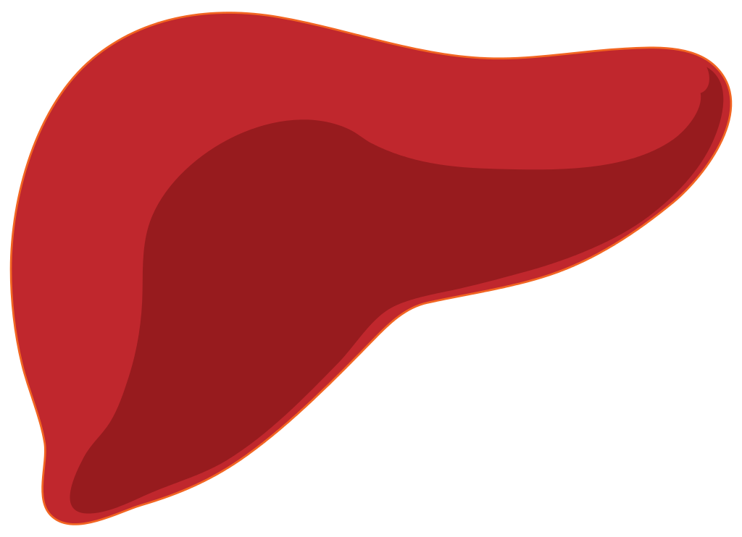
Bempedoic Acid
Citrate
Bempedoic Acid CoA
(active)
Bempedoic Acid
A novel citrate lyase inhibitor
Very Long Chain Acyl CoA synthetase
X
ATP Citrate Lyase
Acetyl CoA
HMG-CoA
HMG-CoA Reductase
Mevalonate
Cholesterol production
Ballantyne CM, et al. Cardiovasc Drugs Ther. 2021;35:853-864

Slide 33
Bempedoic Acid
Approved in 2020 as an adjunct to diet and maximally tolerated statin therapy in heterozygous FH or established ASCVD for additional LDL-C reduction
Dose: 180 mg orally daily with or without food
Available as bempedoic acid alone (Nexletol) or as a fixed-dose combination with ezetimibe (Nexlizet)
Adverse effects
Hyperuricemia (0.8 mg/dL uric acid increase), tendon rupture
Others reported (e.g., atrial fibrillation, anemia, hepatic transaminases, creatine kinase)
Drug-drug interaction with simvastatin (restrict dose to 20 mg) and pravastatin (restrict dose to 40 mg)
Ballantyne CM, et al. Cardiovasc Drugs Ther. 2021;35:853-864
Nexletol (bempedoic acid) [package insert]. Ann Arbor,MI: Esperion Therapeutics, Inc.; 2020

Slide 34
Bempedoic Acid: Clinical Efficacy
CLEAR Harmony
CLEAR Tranquility
Ray KK, et al. N Engl J Med. 2019;380:1022–1032. Ballantyne CM, et al. Atherosclerosis. 2018;277:195-203.

Slide 35
Bempedoic Acid: Clinical Efficacy
Modest and variable additional LDL-C reduction (not placebo corrected)
CLEAR Harmony: add-on to statin 16.5%
CLEAR Wisdom: add-on to statin 15.1%
CLEAR Serenity: monotherapy 23.6%
CLEAR Tranquility: add-on to ezetimibe 23.5%
Fixed-combination: with ezetimibe 36%
Ballantyne CM, et al. Atherosclerosis. 2018;277:195-203. Laufs U, et al. J Am Heart Assoc. 2019; 8:e011662. Ray KK, et al. N Engl J Med. 2019;380:1022–1032.

Slide 36
Bempedoic Acid
CLEAR Outcomes Trial
Randomized, double-blind, placebo-controlled clinical trial
14,014 patients included patients with all of the following:
Established ASCVD or have a high risk of developing ASCVD; documented statin intolerance; LDL-C ≥100 mg/dL on maximally tolerated lipid-lowering therapy
Estimated duration is 3.75 years; completion date is December 2022
NOTE: 22.4% of statin intolerance patients tolerate a low dose statin (rosuvastatin <5 mg, atorvastatin <10 mg, simvastatin<10 mg, lovastatin <20 mg, pravastatin <40 mg, fluvastatin <40 mg or pitavastatin <2 mg)
Nicholls, SJ, et al. Am Heart J. 2021;235:104-112. https://clinicaltrials.gov/ct2/show/NCT02993406

Slide 37
Evinacumab-dgnb
Fully human monoclonal antibody against angiopoietin-like 3 (ANGPTL3)
ANGPTL3
X
Inhibition of
Lipoprotein lipase
Inhibition of Endothelial lipase
Evkeeza. Prescribing information. Regeneron; 2021.

Slide 38
Evinacumab-dgnb: Clinical Efficacy
Homozygous FH: Double-blind, placebo-controlled trial, in 65 patients:
47.1% decrease in LDL-C with evinacumab
1.9% increase in LDL-C with placebo
Heterozygous FH: Double-blind, placebo-controlled trial in 272 patients:
29.7%-49.9% decrease in LDL-C with evinacumab
0.6-8.8% increase in LDL-C with placebo
Raal FJ, et al. N Engl J Med. 2020;383(8):711-720. Rosenson RS, et al. N Engl J Med. 2020;383(24):2307-2319.

Slide 39
Evinacumab-dgnb
Approved in 2021 as an adjunct to other LDL-C lowering therapies for the treatment of adult and pediatric patients, aged 12 years and older, with homozygous familial hypercholesterolemia
Dose: 15 mg/kg IV once every 4 weeks (over 60 min)
Available as evinacumab-dgnb (Evkeeza)
Injection: 345 mg/2.3 mL and 1,200 mg/8 mL single-dose vials
Warnings for serious hypersensitivity reactions and embryo-fetal toxicity
Adverse effects
Nasopharyngitis, influenza-like illness, dizziness, rhinorrhea, and nausea
Evkeeza. Prescribing information. Regeneron; 2021.

Slide 40
Just around the corner… Inclisiran
Small-interfering RNA therapy that selectively blocks PCSK9 protein production
Submitted to the FDA for approval for secondary prevention patients with ASCVD and familial hypercholesterolemia (FH)
300 mg subcutaneously initially, at 3 months, then every 6 months
Prescription Drug User Fee Act (PDUFA) date:
January 1, 2022

Slide 41
Inclisiran: Clinical Efficacy on Maximally Tolerated Statin
ORION-9: Heterozygous FH
ORION-10/11: ASCVD or equivalent
Ray KK, et al. N Engl J Med 2020;382:1507-19. Raal FJ, et al. N Engl J Med 2020;382:1520-30.

Slide 42
Inclisiran
A Randomized Trial Assessing the Effects of Inclisiran on Clinical Outcomes Among People With Cardiovascular Disease (ORION-4)
15,000 patients age ≥55 years with ASCVD
Randomized to inclisiran sodium 300 mg or placebo on the day of randomization, at 3 months and then every 6-months
Planned median duration of about 5 years
https://clinicaltrials.gov/ct2/show/NCT03705234.

Slide 43
Oral PCSK9 Inhibitor Slashed Cholesterol
Hot off the press from the American Heart Association 2021 meeting:
MK-0616 is an investigative oral PCSK9 inhibitor
Two phase 1 trials showed a 65% reduction in LDL-C when added to a background of statin therapy
Tolerated at doses up to 300 mg with no deaths, serious adverse events, or clinically meaningful trends in laboratory safety tests, vital signs, or electrocardiographs
Johns D, et al "The clinical safety, pharmacokinetics, and LDL-cholesterol lowering efficacy of MK 0616, an oral PCSK9 inhibitor" AHA 2021; Abstract LBS-06.

Slide 44
Patients Needing Further LDL-C Lowering
High- or very-high ASCVD risk
Difficulty following lifestyle modifications
Inability to tolerate statin therapy or higher statin doses
Drug-drug interactions
Nonadherence
Financial barriers
Goal
% LDL-C lowering from baseline in response to therapy
Threshold
LDL-C value if ≥, consider starting or intensifying LDL-C− lowering therapy
Grundy SM, et al. Circulation. 2019;139(25):e1082-e1143.

Slide 45
2018 AHA/ACC/Multisociety Cholesterol Guideline
Interventions focused on improving adherence to prescribed therapy are recommended, including telephone reminders, calendar reminders, integrated multidisciplinary educational activities, and pharmacist-led interventions, such as simplification of the drug regimen to once-daily dosing
Clinicians, health systems, and health plans should identify patients who are not receiving guideline-directed medical therapy and should facilitate the initiation of appropriate guideline-directed medical therapy, using multifaceted strategies
0
Before therapy is prescribed, a patient-clinician discussion should take place to promote shared decision making and should include the potential for ASCVD risk-reduction benefit, adverse effects, drug-drug interactions, and patient preferences
Grundy SM, et al. Circulation. 2019;139(25):e1082-e1143.

Slide 46
Conclusions
ACC/AHA guideline recommendations for management of hypercholesterolemia start with statin-based therapy to target LDL-C lowering
Statin associated muscle symptoms are uncommon and best managed with a patient specific approach
Evinacumab, Bempedoic acid, and Inclisiran are new and novel LDL-C lowering medications
Candidates for further LDL-C lowering despite maximally tolerated statin therapy are often high-risk patients for ASCVD where aggressive lowering is needed

