Slide 1
Choosing Medications Wisely: A Deprescribing Drive to Educate and Implement
Manju T Beier, Pharm D., BCGP, FASCP
Senior Partner, Geriatric Consultant Resources LLC
Adjunct Associate Professor of Pharmacy
The University of Michigan

Slide 2
DISCLOSURES
Dr. Manju Beier has no relevant financial relationships with ineligible companies to disclose.
This continuing education activity is managed by Innovatix* and AffinityCE. Innovatix* is accredited by the Accreditation Council for Pharmacy Education as a provider of continuing pharmacy education.
Innovatix* and AffinityCE as well as planners and reviewers have no relevant financial relationships with ineligible companies to disclose. Neither Innovatix* nor Affinity CE support or endorse any product or service mentioned in this activity. Disclosure will be made when a product is discussed for an unapproved use.
The material presented for this session has been reviewed by the Innovatix* Institute CE Committee and AffinityCE and has been found to be free of any content influence or commercial bias.
Commercial Support was not received for this activity.
*Innovatix now operates under Premier Alternate Site Programs

Slide 3
Learning Objectives
Describe the mission of Choosing Wisely by the American Board of Internal Medicine (ABIM).
Discuss the clinical evidence behind the ASCP Choosing Wisely statements with a specific focus on drug-drug interactions (DDIs).
Explain how deprescribing strategies intersect with Choosing Wisely mission.
Identify opportunities to utilize the ASCP Choosing Wisely statements in your practice with a given case example.

Slide 4
Polling Question #1
Deprescribing is best defined by which of the following?
Stopping one medication per week until they are all discontinued
Discontinuing medications for whom burden exceeds benefit
Discontinuing all medications on admission to hospice
Discontinuing medications, the patient cannot afford

Slide 5
Deprescribing
“Systematic process of identifying and discontinuing drugs in instances in which existing or potential harms outweigh existing or potential benefits.”
Consider
patient’s care goals
functioning
life expectancy
Values and preferences
JAMA Intern Med. 2015;175(5):827-834

Slide 6
When To Consider Deprescribing?
Course Complete
No indication
Resolution of problem
Not Safe!
Prescribing cascade
Beers Criteria meds/high risk/PIMs
START/STOPP UK criteria
Not Effective
Persistent symptoms
Unknown benefit
Drugs for prevention?
Not Aligned with Goals
Palliative care
End of life care
Extreme frailty
Personal preferences
PIMs: potentially inappropriate medications
BMJ 2016;353:i2893 doi: 10.1136/bmj.i2893

Slide 7
Barriers to Stopping Medications
Don’t want to stop meds started by someone else
Perception of inadequate care
Provider-patient relationship
Perception of “giving up”
Concern about adverse withdrawal events
Gnjidic D, et al. Clin Geriatr Med 2012;28:237-253.
Sloane and Zimmerman: JAMDA 2018
Notes:
From Wikipedia:
Although many trials have successfully resulted in a reduction in medication use, there are some known barriers to deprescribing. Physicians interviewed about deprescribing felt medications were overused in the elderly but they were not always comfortable or confident in discontinuing chronic medications.^{[29]} They identified barriers to deprescribing as: lack of evidence for continuing or discontinuing medications for disease prevention among elderly patients, discomfort explaining to patients that medications can be withdrawn because the benefit of drug therapy is no longer clear with declining life expectancy, discomfort with not following guidelines recommending specific drug therapies, not wishing to stop medications started by another physician and patients believing continued medication therapy is needed.
_________________________________
Many of us feel uncomfortable stopping medications because it feels like withdrawing care. Sometimes, we are reluctant to stop medications that were prescribed by someone else, even if we suspect it may be inappropriate, because we do not have the entire history to consider.
But, there is some evidence to support safe medication discontinuation for at least some drugs.

Slide 8
ASCP Deprescribing Mission
Launched November 2018
Manju T. Beier, Chair
Members: diverse backgrounds
Focus on Overall Deprescribing Process
Choosing Wisely Statements as Mission
Intersect with Deprescribing Goals

Slide 9
www.choosingwisely.org

Slide 10
Choosing Wisely: History
In April 2012 the ABIM Foundation, along with Consumer Reports, formally launched the Choosing Wisely campaign with the release of “Top Five” lists from nine specialty societies
http://www.choosingwisely.org/
http://consumerhealthchoices.org/
Choosing Wisely recommendations should not be used to establish coverage decisions or exclusions
Meant to spur conversation about what is appropriate and necessary treatment.
Use the recommendations as guidelines
ABIM: American Board of Internal Medicine

Slide 11
ASCP Choosing Wisely Focus Why Emphasize DDIs?
As pharmacists we need to highlight our role as “medication experts”
Choosing Wisely Statements from around the globe do not include hazardous drug-drug combinations
Emphasize special considerations in older adults:
Increased sensitivity to adverse drug events
Prescribing cascade
Polypharmacy and DDIs
Palliative and end of life care
Less is more approach
DDI: Drug-drug Interactions
Beier MT. Vigilance of Drug-Drug Interactions to Mitigate ADRs: Front and Center for Pharmacists.
Sr Care Pharm 2020; 35:336-7.

Slide 12
ASCP Choosing Wisely Statements: Painstaking Deliberations
Several Virtual Brainstorming Sessions
Select DDI Examples and General MRR Focus
10 Statements Crafted
Craft with Rationale and References
Multiple drafts
Cross Review and Edits
Select Top 5 for Initial Submission
DDI: Drug-drug Interactions
MRR: Medication Regimen Review

Slide 13
ASCP Choosing Wisely Statements Intent and Substance
Craft Statements that are:
Evidence-based
Begin with “do not use” or “don’t recommend” or “don’t prescribe” or “avoid”

Slide 14
CW statements Top Five: Submitted February 2021 to ABIM
Statements reviewed by ABIM (physician and pharmacist reviewer comments)
Statements finalized and re-submitted
Published Online May 2021
https://www.choosingwisely.org/societies/american-society-of-consultant-pharmacists/

Slide 15
General MRR Statements Prescribing Cascade
Don’t initiate medications to treat new and emerging symptoms without first ascertaining that the new symptom is not an adverse drug event of an already prescribed medication.
JAMA Intern Med 2019;179(7):863-864
BMJ 2020 Feb 19;368:m261.
Polypharmacy, inappropriate prescribing, and deprescribing in older people: through a sex and gender lens https://doi.org/10.1016/S2666-7568(21)00054-4

Slide 16
General MRR Statements Medication History
Don’t continue medications at transitions of care without a pharmacist or other qualified health care professional performing a comprehensive medication review to verify accurate and complete medication information in concert with current medical problems.
J Am Coll Clin Pharm 2020;3(2):532-545.
Ann Intern Med 2013;158:397-403.

Slide 17
CNS Statements: Anticholinergic Burden
Don’t recommend highly anticholinergic medications in older adults without first considering safer alternatives or non-drug measures.
JAMA Intern Med 2015;175:401-407
J Am Geriatr Soc 2015;63(12):e8-e18.

Slide 18
CNS Statements: Focus on DDI
Don’t use anticholinergic medications concomitantly with cholinesterase inhibitors in patients with dementia.
J Am Geriatr Soc 2008;56:847–853
Arch Intern Med 2005;165:808-13.

Slide 19
Bleeding Risk: Focus on DDI
Don’t use two or more medications that are known to increase the risk of bleeding without evaluating the potential risks and benefits. These medications include direct oral anticoagulants (DOACs), warfarin, aspirin, selective serotonin reuptake inhibitors (SSRIs), antiplatelet agents, nonsteroidal anti-inflammatory drugs (NSAIDs), and corticosteroids.
JAMA 2017;318(13):1250-1259
Am J Gastroenterol. 2014 Jun;109(6):811-9.

Slide 20
Fast Forward 2021-2022 and Beyond…
New Vistas to Conquer
New Collaborations...
Join AMDA and ASCP
Drive to deprescribe D2D Initiative:
https://paltc.org/drive2deprescribe

Slide 21
Start Spreading the News…….
https://www.choosingwisely.org/societies/american-society-of-consultant-pharmacists/
Presented CW statements on a D2D Webinar:
On October 21, 2021
Focus on anticholinergic burden
Focus on prescribing cascade

Slide 22
Work in Progress for Deprescribing Task Force:
Shared Decision-Making Resources
Pharmacist as Team Leader/Conversation Starter:
PACE
ALFs
PCMH
Hospice
Pharmacist-initiated Deprescribing Studies:
Community and LTCFs
Focus on RCTs
Compile and Curate
Publish

Slide 23
Case Discussion: Application of CW Statements/Rationale

Slide 24
Mini Case Discussion
Patient: MJ, 75-year-old Caucasian woman
PMH: hypertension, osteoarthritis, type 2 diabetes, depression
Current problem: fall with fractures on ER admission
Med history:
amlodipine 2.5 mg bid
sertraline 100mg
acetaminophen 500 mg prn,
metformin 1000mg ER qpm
ibuprofen 400 mg prn
Recent med changes:
furosemide 20 mg for new onset edema
followed 2 weeks later by tolterodine 2mg ER daily for OAB

Slide 25
Polling Question #2
Regarding her recent medication changes, which prescribing cascades are suspected?
A: furosemide following amlodipine
B​: sertraline following ibuprofen
C​: tolterodine following furosemide
D: A and C

Slide 26
The Prescribing Cascade More relevant than ever!
DRUG 1
Adverse drug effect interpreted as new medical condition
DRUG 2
Adverse drug effect
Rochon PA, Gurwitz JH. BMJ 315: 1096-99, 1997
Notes:
NSAID – new drug for hypertension (e.g., thiazide, ACE inhibitor)
Amlodipine – new drug for edema (e.g., furosemide)
Thiazide diuretic – new drug for gout (e.g., colchicine, allopurinol)
Metoclopramide – new drug for PD (e.g., levodopa)
Levothyroxine – new drug for atrial fibrillation (e.g., amiodarone, diltiazem)

Slide 27
Calcium Channel Blockers and Prescribing Diuretics
Seen with dihydropyridine CCBs
Prevalence of lower extremity edema with CCBs : 2%-25%
vasodilation of local peripheral arterioles
more common in women
Cause of edema frequently not investigated
Diuretics may further compound issues:
electrolyte/volume changes
overactive bladder symptoms
Falls!!
Drugs Aging 37, 77–81 (2020).
BMC Geriatr 21, 297 (2021).

Slide 28
Antihypertensives Prescribing Cascades Increased Vigilance and Scrutiny!
calcium channel blocker causing edema leading to loop diuretic
angiotensin-converting enzyme inhibitors causing dry cough leading leading to antitussive
β-blocker causing sexual dysfunction leading to phosphodiesterase-5 inhibitor
diuretic causing urinary frequency leading to antimuscarinic
all antihypertensives causing dizziness leading to antihistamine or benzodiazepine Rx
JAMA Intern Med. 2020;180(5):651–652. doi:10.1001/jamainternmed.2019.7082
JAMA Intern Med. 2020;180(5):643–651. doi:10.1001/jamainternmed.2019.7087

Slide 29
Another Prescribing Cascade to Consider!
Older patients who receive gabapentinoids are more likely to receive diuretics subsequently:
patients who received gabapentinoids were significantly more likely to receive diuretic prescriptions than those who did not receive gabapentinoids (2.0% vs. 1.3%).
With adjustment for various potentially confounding variables, the difference remained significant (hazard ratio, 1.44).
Risk for being prescribed a diuretic was higher among patients who received high-dose gabapentinoids (HR, 2.34 at 180 days).
Evidence of a gabapentinoid and diuretic prescribing cascade among older adults with lower back pain. J Am Geriatr Soc 2021 Oct; 69:2842. https://doi.org/10.1111/jgs.17312
Notes:
An observational study suggests a “prescribing cascade,” in which older patients who receive gabapentinoids are more likely to receive diuretics subsequently.
Edema is a well-described side effect of gabapentinoid drugs (i.e., gabapentin and pregabalin). In this study from Ontario, Canada, researchers used provincial databases to examine whether gabapentinoid use was followed by diuretic prescriptions — a so-called “prescribing cascade” in which a drug is prescribed to treat an adverse effect of another drug. The study population was 260,000 older adults (age, >65) with newly diagnosed back pain or sciatica; gabapentinoids had been prescribed for ≈8000 of these patients. The researchers limited the analysis to patients with these diagnoses to create a reasonably homogeneous study population.
During the 90 days after diagnoses of back pain, patients who received gabapentinoids were significantly more likely to receive diuretic prescriptions than those who did not receive gabapentinoids (2.0% vs. 1.3%). With adjustment for various potentially confounding variables, the difference remained significant (hazard ratio, 1.44). Risk for being prescribed a diuretic was higher among patients who received high-dose gabapentinoids (HR, 2.34 at 180 days).
COMMENT
This study indirectly supports previous observations that gabapentinoids can cause edema. Although the absolute excess of diuretic prescribing was small, the findings are particularly noteworthy given the adverse effects of diuretics in older patients. An equally noteworthy aspect of this study is the nontrivial frequency of off-label gabapentinoid prescribing for low back pain and sciatica: Gabapentinoids are largely ineffective for these conditions and frequently cause other adverse effects in older patients (NEJM JW Gen Med May 1 2019 and JAMA Intern Med 2019; 179:695).
CITATION(S):

Slide 30
CNS Statements: Anticholinergic Burden
Don’t recommend highly anticholinergic medications in older adults without first considering safer alternatives or non-drug measures.
JAMA Intern Med 2015;175:401-407
J Am Geriatr Soc 2015;63(12):e8-e18.

Slide 31
Alertness
Attention
Working memory
Executive function
Reaction time
Vigilance

Slide 32
Sedating Antihistamines
Level of cognitive impairment does not always correlate with the perceived level of sedation.
Weiler JM. Ann Intern Med.2000;132:354-363.
Notes:
Driving simulator

Slide 33
Bleeding Risk: Focus on DDI
Don’t use two or more medications that are known to increase the risk of bleeding without evaluating the potential risks and benefits. These medications include direct oral anticoagulants (DOACs), warfarin, aspirin, selective serotonin reuptake inhibitors (SSRIs), antiplatelet agents, nonsteroidal anti-inflammatory drugs (NSAIDs), and corticosteroids.
JAMA 2017;318(13):1250-1259
Am J Gastroenterol. 2014 Jun;109(6):811-9.

Slide 34
Special Problems with SSRIs/SNRIs
Increased upper GI bleeding — weak association from epidemiology studies
Caution for combinations of SSRIs and ASA and/or NSAIDs
Consider preventive strategy (such as PPIs) in those SSRI users at high risk?
Not yet part of AGS 2019 Criteria
Risk of upper gastrointestinal bleeding with selective serotonin reuptake inhibitors with or without concurrent nonsteroidal anti-inflammatory use:
a systematic review and meta analysis. Am J Gastroenterol. 2014 Jun;109(6):811-9. doi: 10.1038/ajg.2014.82. Epub 2014 Apr 29.
Yuan Y, Tsoi K, Hunt RH. Selective serotonin reuptake inhibitors and risk of upper GI bleeding: confusion or confounding? Am J Med 2006;119:719-27.

Slide 35
Bleeding Risks with Antidepressants A nonsystematic review of meta-analyses
Serotonin reuptake inhibitors (SRIs) increased risk of bleeding by 1.16-2.36-fold
The risk is synergistic between SRIs and nonsteroidal anti-inflammatory agents (OR 3.17-10.9)
Acid reducing medications may mitigate risk of GI bleeds in chronic NSAIDs and SRI users (OR 0.98-1.1)
Compared with aspirin alone, use of SRIs with aspirin is associated with increased risk of bleeding (HR=1.42, 95% CI- 1.08-1.87)
Dual antiplatelet therapy alone vs. with SRI, increased risk of bleeding (HR-1.57, 95% CI-1.07-2.32)
Clinical Pearls
SSRIs | Increase gastric acidity, as well as inhibition of platelet aggregation
Longitudinal exposure | SRIs can increase gastric acidity almost immediately may take a week to deplete platelets of serotonin
Bixby, A., VandenBerg, A., Bostwick, J. et al. Clinical Management of Bleeding Risk with Antidepressants. Annals of Pharmacotherapy. 2019, Vol. 53(2) 186-194.

Slide 36
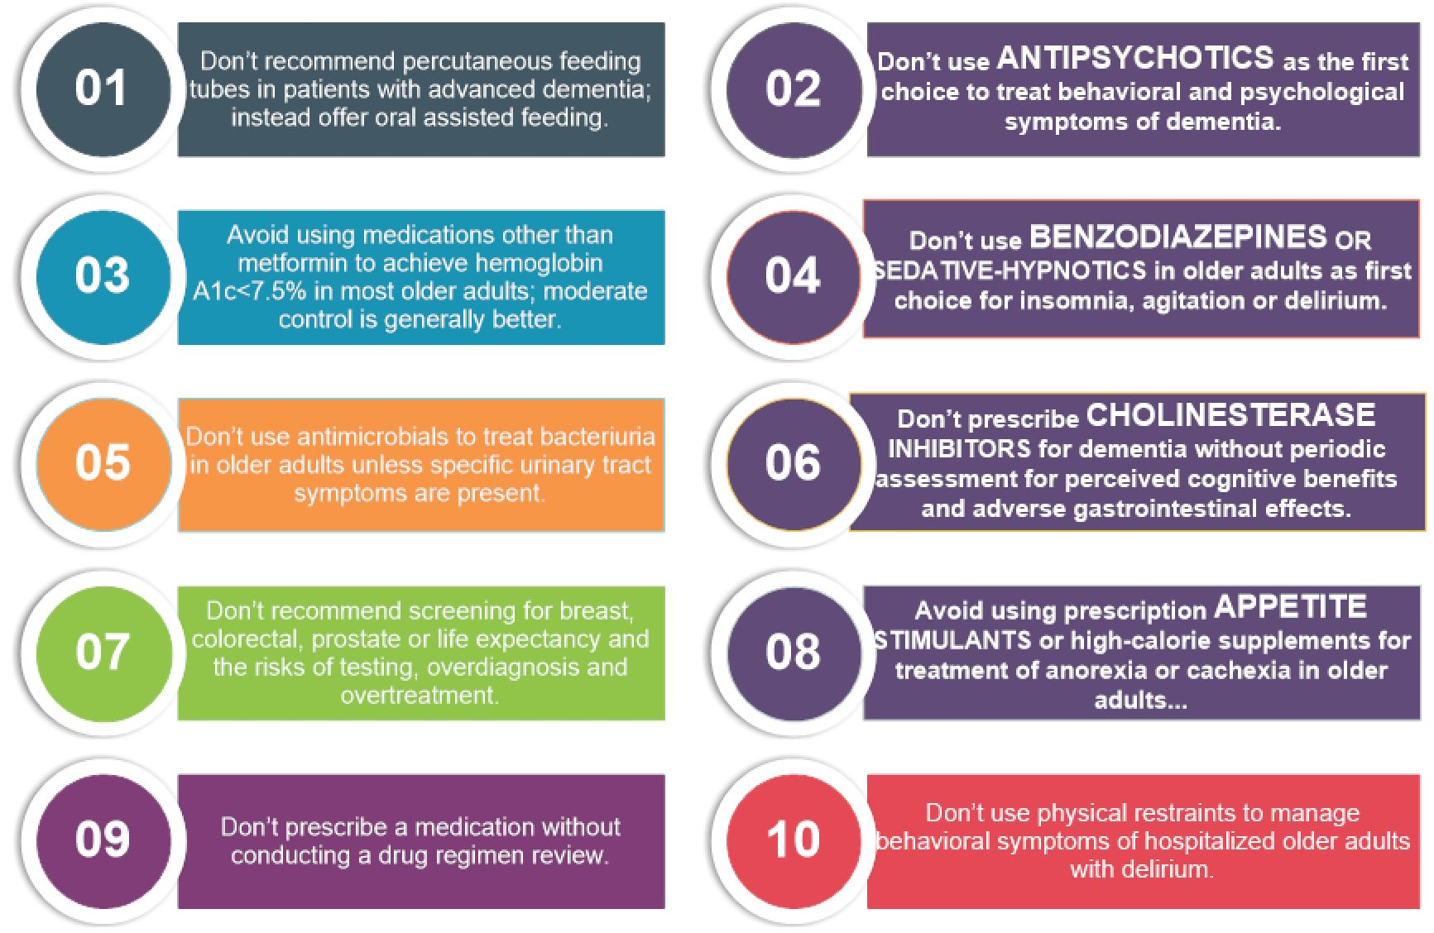
American Geriatrics Society “Choosing Wisely”
√√
√
√√
√
√√
√√
√
American Geriatrics Society Choosing Wisely; Ten Things Clinicians and Patients Should Question. AGS Website. 2015 https://www.choosingwisely.org/societies/american-geriatrics-society/
Notes:
American Geriatrics Society’s “Choosing Wisely”
ten recommendations for things clinicians and patients
should question, seven of ten focus on medication use,
with four of the ten explicitly targeting psychoactive
medication use.

Slide 37
Deprescribing Opportunities For Pharmacist Engagement
Initiate Conversations
Exercise Persistence
Be Tenacious
Be Resourceful
Be Patient/Resident Focused
Educate on ALL Levels

Slide 38
Clinical Pearls
Check for adherence!
Reconcile meds (TOC opportunities)
Consolidate/Streamline meds
Enhanced Vigilance:
Identify Additive Adverse Drug Effects
Identify Possible Prescribing Cascade
Identify Potential DDIs
Construct evidence-based case for deprescribing in concert with goals (shared decision making)

Slide 39
Online Resources
Canadian Deprescribing Network
https://www.deprescribingnetwork.ca
Choosing Wisely
https://www.choosingwisely.org
US Deprescribing Research Network
https://deprescribingresearch.org
https://deprescribingresearch.org/resources-2/resources-for-clinicians/

Slide 40
Summary
Choosing Wisely (CW) as described by ABIM means choosing tests/medications carefully, and that are supported by evidence and free from harm.
The clinical evidence behind CW statements were selected as they apply to DDIs, primarily.
Deprescribing as a strategy aligns closely with ASCP CW statements intent and purpose.
The opportunities presented by CW statements encompass medication review, medication management and medication reconciliation.

Slide 41
Beier Acronym
PAVE
Polypharmacy
Assessment
Vigilance
Effort

Slide 42
Thank You!

